Slide 2
80% of labour fees transferred to Tamkeen
Funds invested in Human Capital development & private sector support programs
Labour fees set and collect on expatriates and employees

Slide 3
Job
Seekers
Graduates
Students
Enterprises
Entrepreneurs
Employees

Slide 4
Enterprise Support Pathways
Existing companies looking to grow and expand
Ta’sees
Numow
New companies, starting their journey
Training
Existing Employees Trainings
Notes:
Tamkeen aims to support the private sector by serving Newly Established Companies, Existing Companies looking to grow, as well as Existing Employees in need of training to progress in their careers.

Slide 5
Ta’sees Startup Programs
50% Up to BD 5K
40-60%
Feasibility Support Scheme
Riyadat
40-60%
Finance Scheme
Entrepreneurship Incubators
BD5K
Pre-seed Scheme

Slide 6
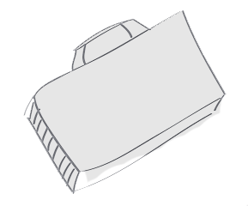
Numow Growth Support
Equipment
Marketing
Quality
Management
Career Progression Program
Promotion
IT
Infrastructure
Business
Plan
Research
Finance Scheme
$

Slide 7
TAMKEEN ENTERPRISE SUPPORT PROGRAMS
Start Up
Growth
Finance
Employee Training
Continuous Development
50% Subsidy
50% Interest
50 %Guarantee
Feasibility
Employment Support &
Career Progression
Professional
Certifications
Pre-Seed Capital
Business Support Grant
Consultancy
Technical Assistance
Marketing Support
Exhibition Attendance
Quality Management
Bahrain Development Bank
Incubation
Bahrain Islamic Bank
Kuwait Finance House
Khaleeji Commercial House
Standard Chartered Bank
BMI Bank

Slide 8
e7trf
Licensed Training provider by MOL
50/50
Overseas
100%
reimbursement upon completion
Online
100% - 50%

Slide 9
Enterprise Support Process
NOTES:
Original documents:
1) Authorization letter
2) Undertaking letter
3) Bank statement
4) Financials
Site visits are exempted for:
1) Well known enterprises
2) Previously visited within one year
3) Other reasons subject to management discretion.
Post delivery inspection for:
1) Marketing production
2) Technical items
3) Local exhibitions
The payment can be made under the name of the customer or the service provder.
1
2
3
30 min
4
START
Register
Online
Submit online application
Information Verification
Provide original documents *
5
6
7
8
Book site
visit *
Attend evaluation meeting
Finalize execution
plan
Submit quotations/ proposals
9
10
11
12
10
END
Provide security cheque and receive final approval
Submit proof
of payment
Post delivery
Inspection*
Receive
Payment*

Slide 12
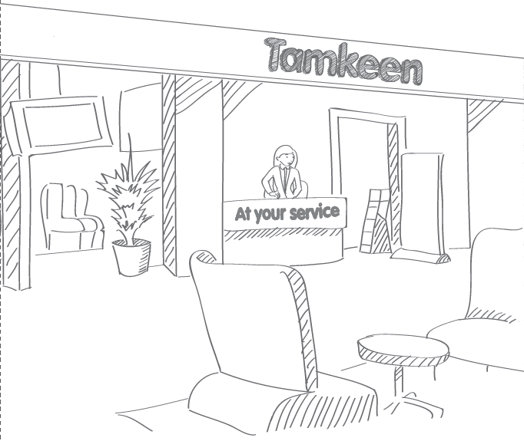
Branches:
Seef Mall
Enma Mall
Sitra Mall
BCCI Branch
Working hours:
Sunday- Thursday
8 am – 4 pm

