Slide 1
2nd Part
The Initiative

Slide 2
The initiative
The problem
Background of Wellness and Health Cluster initiative
Global wellness economy
Vision, Mission , Objectives , stakeholders partners ,activities, and the road map
Indicators of success

Slide 3
The problem 1/2
Bahrain and Gulf States are experiencing a dramatic increase in non-communicable disease (NCD), such as cardiovascular disease (CVD), diabetes and cancer.
All of these disease have common risk factors related to unhealthy life styles

Slide 4
The problem 2/2
In the Gulf region it is estimated that 36 billion US$ are spent every year on health with emerging risks due to nutrition and sedentary behavioral habits
7 out of 10 adult Bahraini are either overweight or obese
4 out of 10 are hypertensive
4 out of 10 having high cholesterol
15% having DM

Slide 5
Entrepreneurs are seeing problems as opportunities

Slide 6
Initiative of Health and Wellness is an Innovative Solution for National Health Problem

Slide 7
Back ground of initiative 1/3
UNIDO , through its Arab International Center for Entrepreneurship & Investment Training (AICEI) based in Bahrain is developing a program for the creation and promotion of productive businesses and jobs around wellness and health hubs and clusters.

Slide 8
Back ground of initiative 2/3
The idea is based on the growing problem of Non-Communicable Diseases that is occurring in the Gulf countries which increases Health hazards and has also a negative impact on productivity and people wellbeing.

Slide 9
Back ground of initiative 3/3
So in order to address these problems but also to generate new business opportunities with a positive impact on income and job creation, the concept of establishing Wellness and Health Hubs and clusters (WHHCs) was developed

Slide 11
Leading and unique health and wellness cluster in the region that create economic growth, and improves quality of people’s life
Vision

Slide 12
To create Profitable business while providing an Innovative Solution for National Health Problem
Mission

Slide 13
Objectives of the initiative 1/3
Increase awareness of local communities on how to live a balanced and healthier life and access to services and products;

Slide 14
Objectives of the initiative 2/3
Generate new business opportunities and develop wellness and health clusters

Slide 15
Sensitize entrepreneurs on the theme of wellness and the need to improve the conditions of workers and their families in a Corporates Social Responsibility and sustainability perspective
Objectives of the initiative 3/3

Slide 16
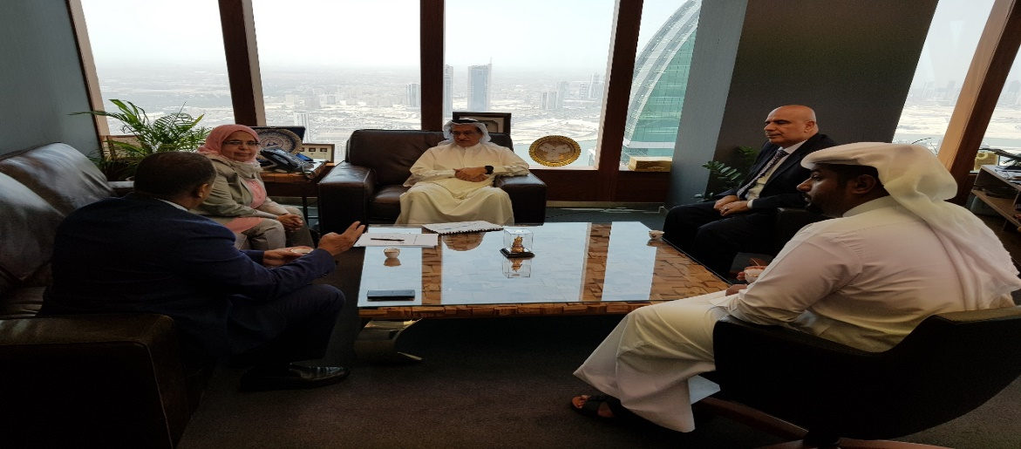
Stakeholders
UNIDO
Supreme Council for Environment
Supreme Council of Health
Ministry of Health

Slide 17
Partnerships
Entrepreneurs
Tamkeen
NHRA
MOCI
Chamber of Commerce
MOE
MOYS
Universities
Banks
Media
NGOS such as BBWS

Slide 18
Health and Wellness Activities
Education and Training Institute
Aerobic Fitness Gyms and Clubs
Hospital & Healthcare Centers
Nutrition and Diet
IT and application
Sporting Activities
Resort & Spas
Shops and Retail
Restaurants
Scope open for entrepreneurs innovation and creativity

Slide 19
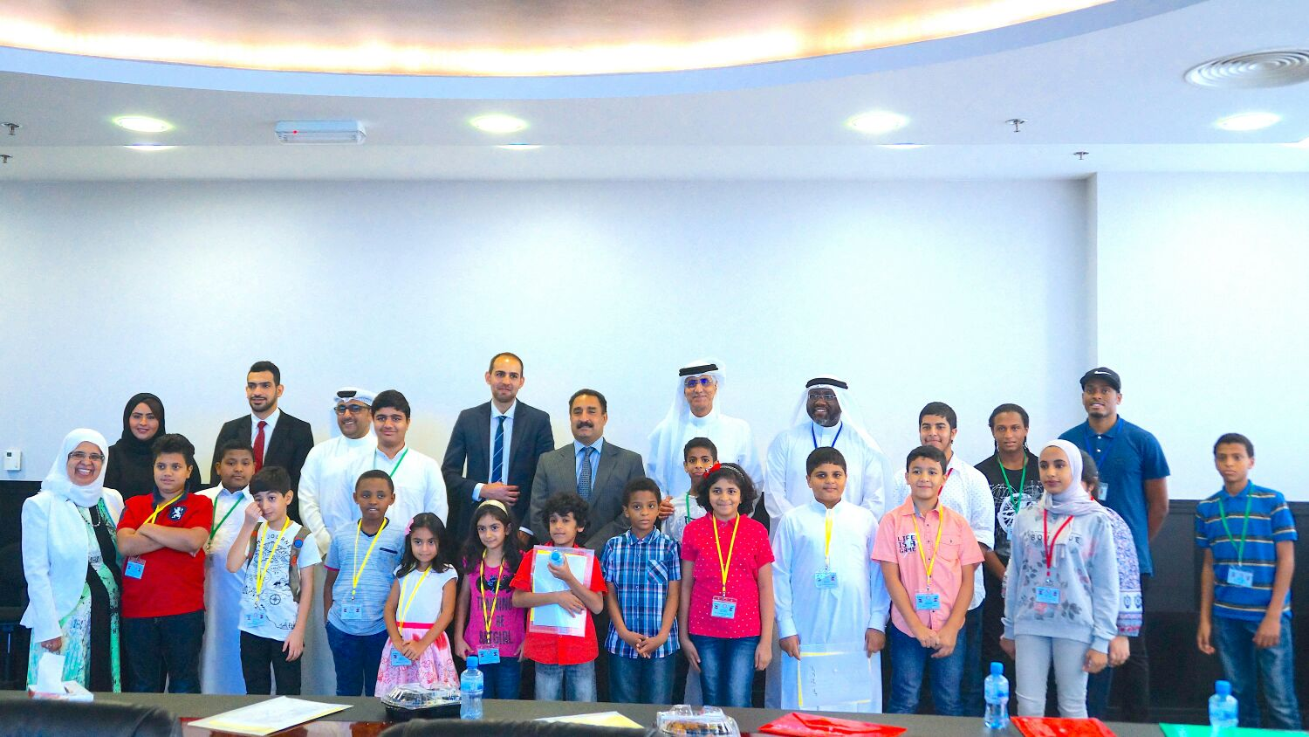
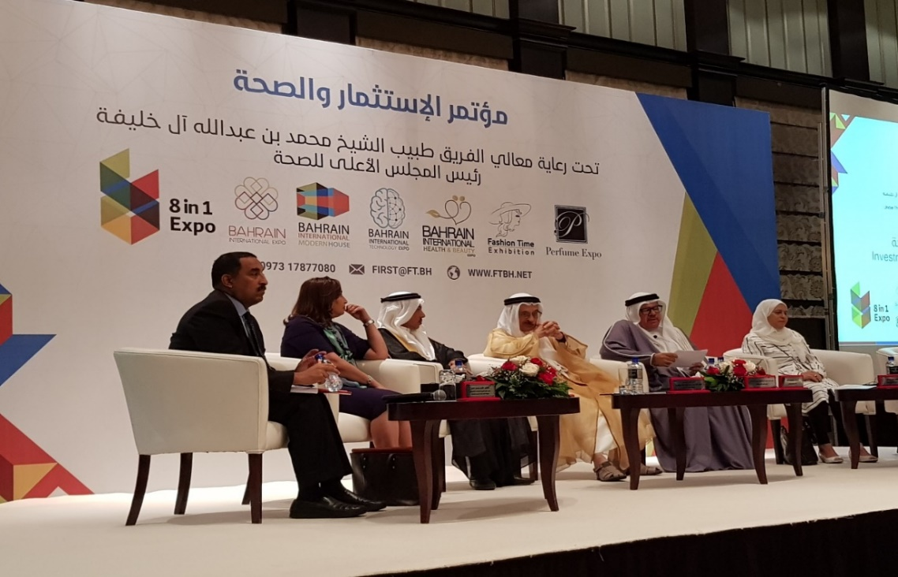
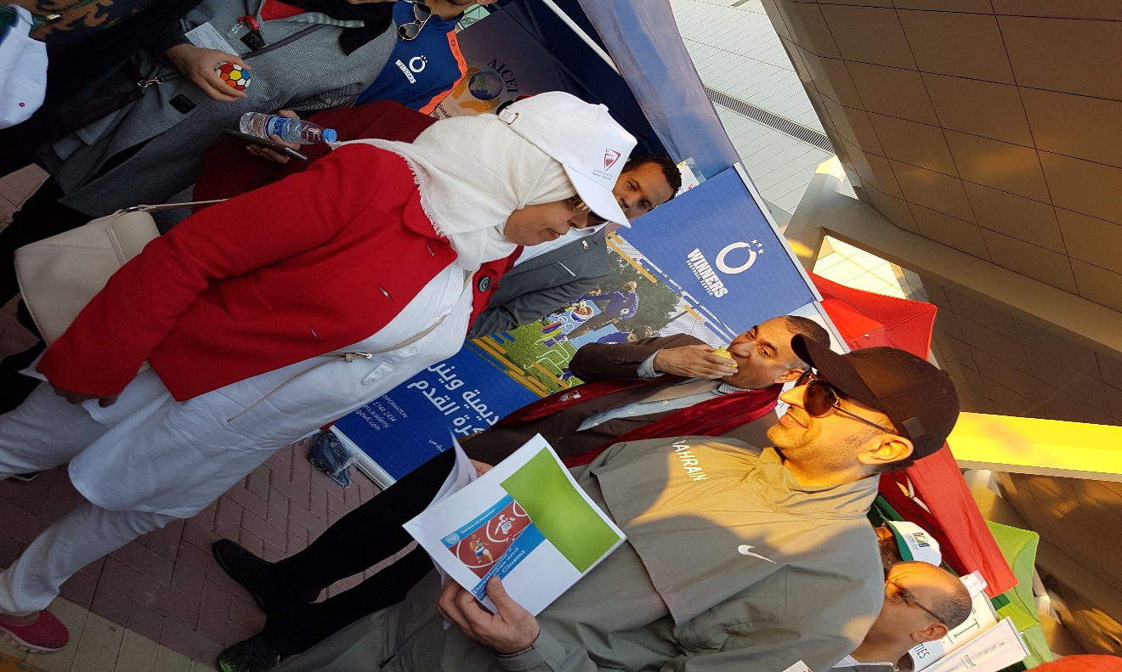
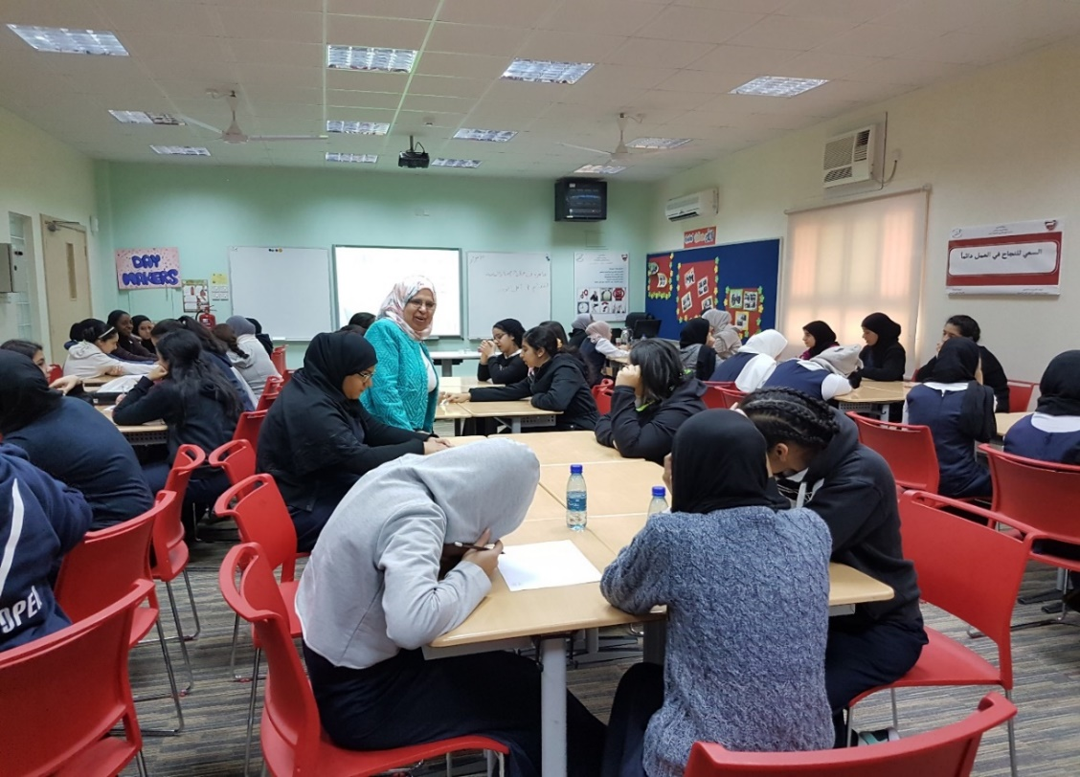

Slide 21
Health and Wellness Cluster project Logic Model

Slide 22
Indicators of success 1/2
Number of health awareness session (lecture, event, media
Number of H&W presentation held in ARCEIT Course
Number of health and wellness startup business

Slide 23
Number of Counseling session held for health and wellness Entrepreneurs
Indicators of success 2/2
Number of activities that introduced health and wellness to students and public (lecture, event, media…
Number of touch point with stakeholders and partners e.g. meeting, workshop, conference

Slide 24
Please follow us
@UNIDOBahrain
ajowder@unido.orgr

Slide 25
Thanks for your attention

