Slide 1
Health and wellness
Cluster

Slide 2
Contents
1st Part Health awareness
2nd Part health and wellness initiative

Slide 3
Definition of Health
Health is a state of complete physical, mental and social well-being and not merely the absence of disease or infirmity” WHO 1948

Slide 4
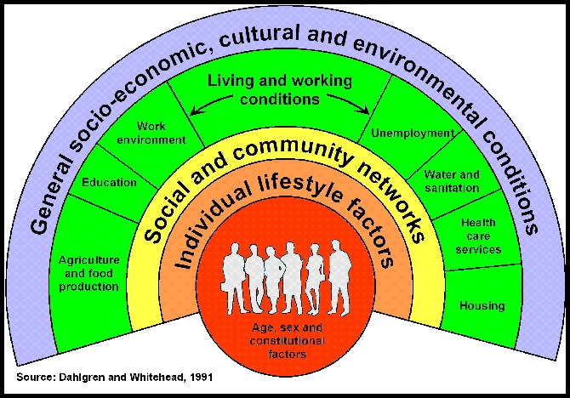

Slide 5
Quality of life
Disease and complication
QOL
Diseases
(Reactive)
(Proactive)
Healthy behavior
Un healthy behaviors
Peace and security
Healthy Housing
Un healthy Housing
Good income
Safe Environment
Poverty
Pollution
(Creative)
Ignorance
Education
Unemployment
Insecurity
اEmployment
Dr.Amal Al Jowder Model

Slide 6
Today definition of Health
Health is a dynamic rather than abstract state .
Health is a resource for everyday life , not an objective of living
The spiritual dimension of health is increasingly
recognized
So with such comprehensive definition you may agree with me that :
Health = Quality of life

Slide 7
Components of Health
Physical health
Mental health
Social health
Spiritual health
Each component can be defined as an essential part of overall health of an individual

Slide 8
Factors affecting health
Quality of medical care is only 10%.
Heredity accounts for 18%
Environment is 19%.

Slide 9
Factors affecting health
Everyday lifestyle choices are 53%.
The decisions people make about their life and habits are the largest factor in determining their state of health & wellness.
The U.S. Centers for Disease Control and Prevention report

Slide 10
Wellness
National Wellness Institute defines wellness as an active process through which people became aware of , and make choices towards a more successful existence

Slide 11
Wellness

Slide 12
Health promotion
Health promotion is the process of enabling people to increase control over, and to improve their health
In simple word : making health easier choice
Ottawa charter on health promotion 1986

Slide 13
ACTION AREA ACCORDING TO OTTAWA CHARTER
1.Build Healthy Public Policy.
2.Create Supportive Environments.
3.Strengthen Community Actions.
4.Develop Personal Skills.
5.Re-orient Health Services.

Slide 14
Who is In charge of Health
Individuals
Families
Government
Academic instutions
NGOs
Private sectors
International organizations

Slide 15
The initiative
The problem
Background of Wellness and Health Cluster initiative
Global wellness economy
Vision, Mission , Objectives , stakeholders partners ,activities, and the road map
Indicators of success

Slide 16
The problem 1/2
Bahrain and Gulf States are experiencing a dramatic increase in non-communicable disease (NCD), such as cardiovascular disease (CVD), diabetes and cancer.
All of these disease have common risk factors related to unhealthy life styles

Slide 17
The problem 2/2
In the Gulf region it is estimated that 36 billion US$ are spent every year on health with emerging risks due to nutrition and sedentary behavioral habits
7 out of 10 adult Bahraini are either overweight or obese
4 out of 10 are hypertensive
4 out of 10 having high cholesterol
15% having DM

Slide 18
Entrepreneurs are seeing problems as opportunities

Slide 19
Initiative of Health and Wellness is an Innovative Solution for National Health Problem

Slide 20
Back ground of initiative 1/3
UNIDO , through its Arab International Center for Entrepreneurship & Investment Training (AICEI) based in Bahrain is developing a program for the creation and promotion of productive businesses and jobs around wellness and health hubs and clusters.

Slide 21
Back ground of initiative 2/3
The idea is based on the growing problem of Non-Communicable Diseases that is occurring in the Gulf countries which increases Health hazards and has also a negative impact on productivity and people wellbeing.

Slide 22
Back ground of initiative 3/3
So in order to address these problems but also to generate new business opportunities with a positive impact on income and job creation, the concept of establishing Wellness and Health Hubs and clusters (WHHCs) was developed

Slide 24
Leading and unique health and wellness cluster in the region that create economic growth, and improves quality of people’s life
Vision

Slide 25
To create Profitable business while providing an Innovative Solution for National Health Problem
Mission

Slide 26
Objectives of the initiative 1/3
Increase awareness of local communities on how to live a balanced and healthier life and access to services and products;

Slide 27
Objectives of the initiative 2/3
Generate new business opportunities and develop wellness and health clusters

Slide 28
Sensitize entrepreneurs on the theme of health and wellness
Objectives of the initiative 3/3

Slide 29
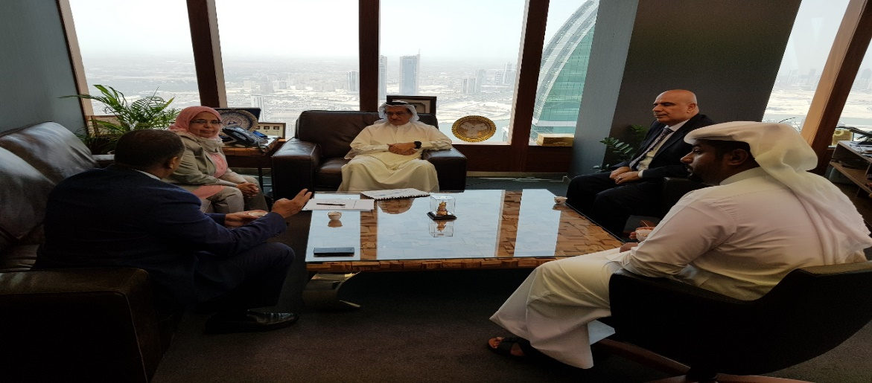
Stakeholders
UNIDO
Supreme Council for Environment
Supreme Council of Health
Ministry of Health

Slide 30
Partnerships
Entrepreneurs
Tamkeen
NHRA
MOCI
Chamber of Commerce
MOE
MOYS
Universities
Banks
Media
NGOS such as BBWS

Slide 31
Health and Wellness Activities
Education and Training Institute
Aerobic Fitness Gyms and Clubs
Hospital & Healthcare Centers
Nutrition and Diet
IT and application
Sporting Activities
Resort & Spas
Shops and Retail
Restaurants
Scope open for entrepreneurs innovation and creativity

Slide 32
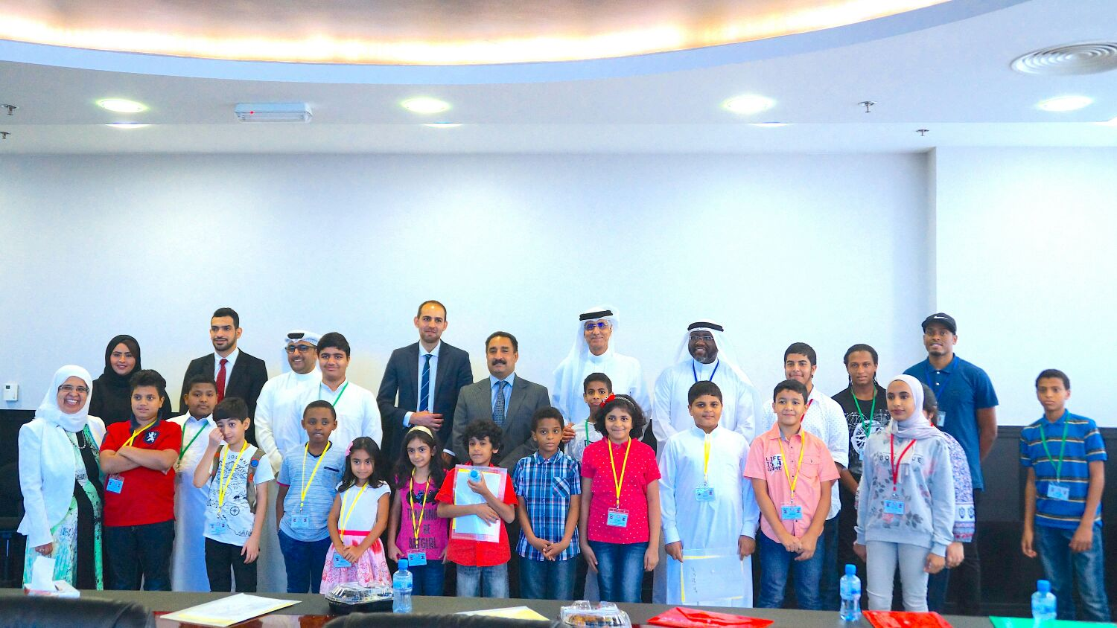
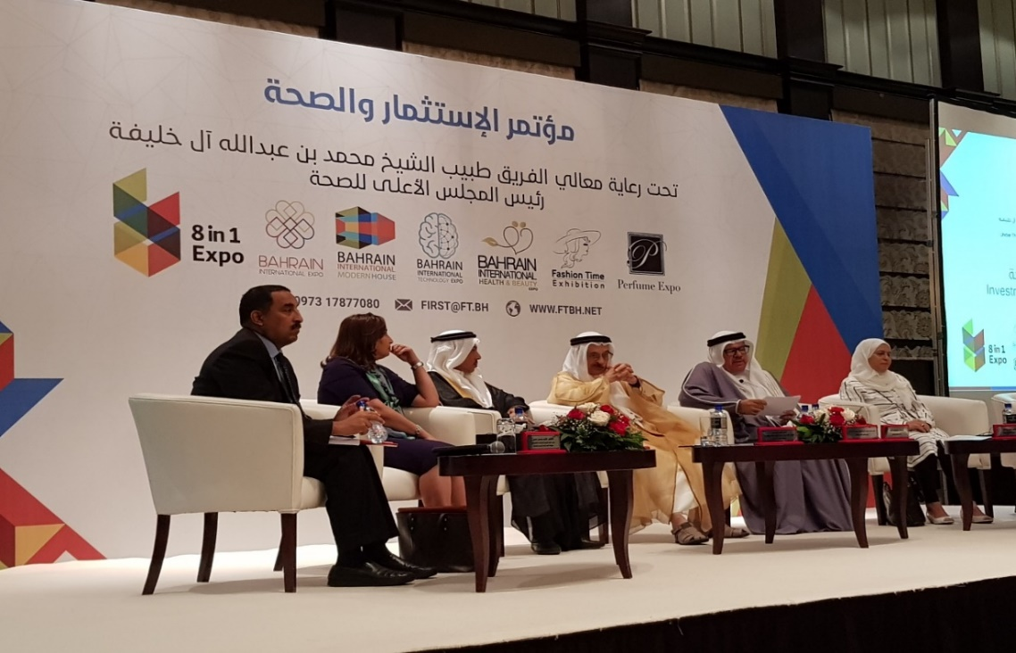
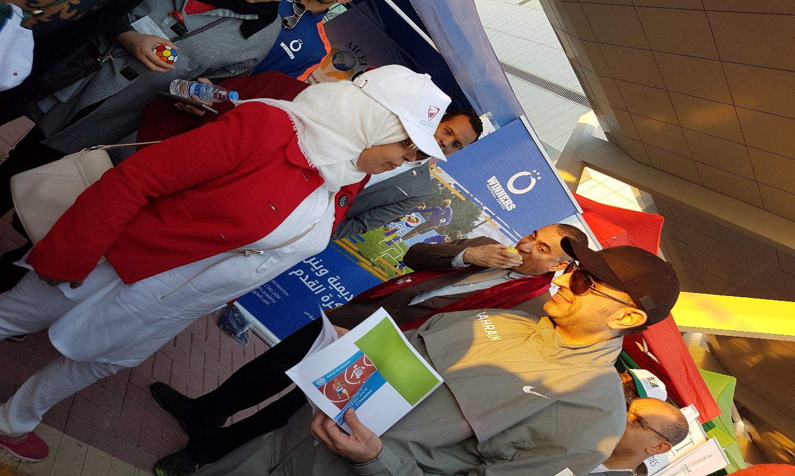
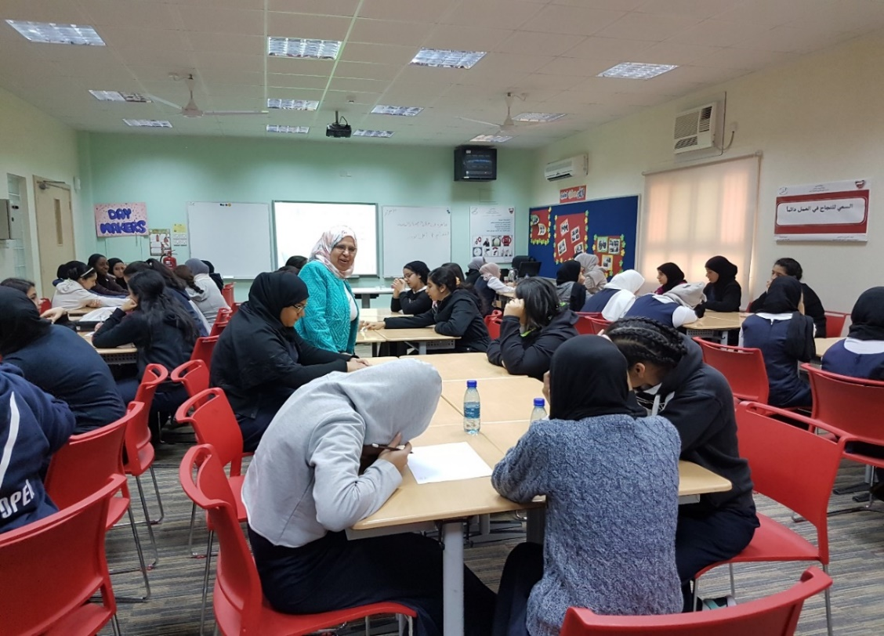

Slide 33
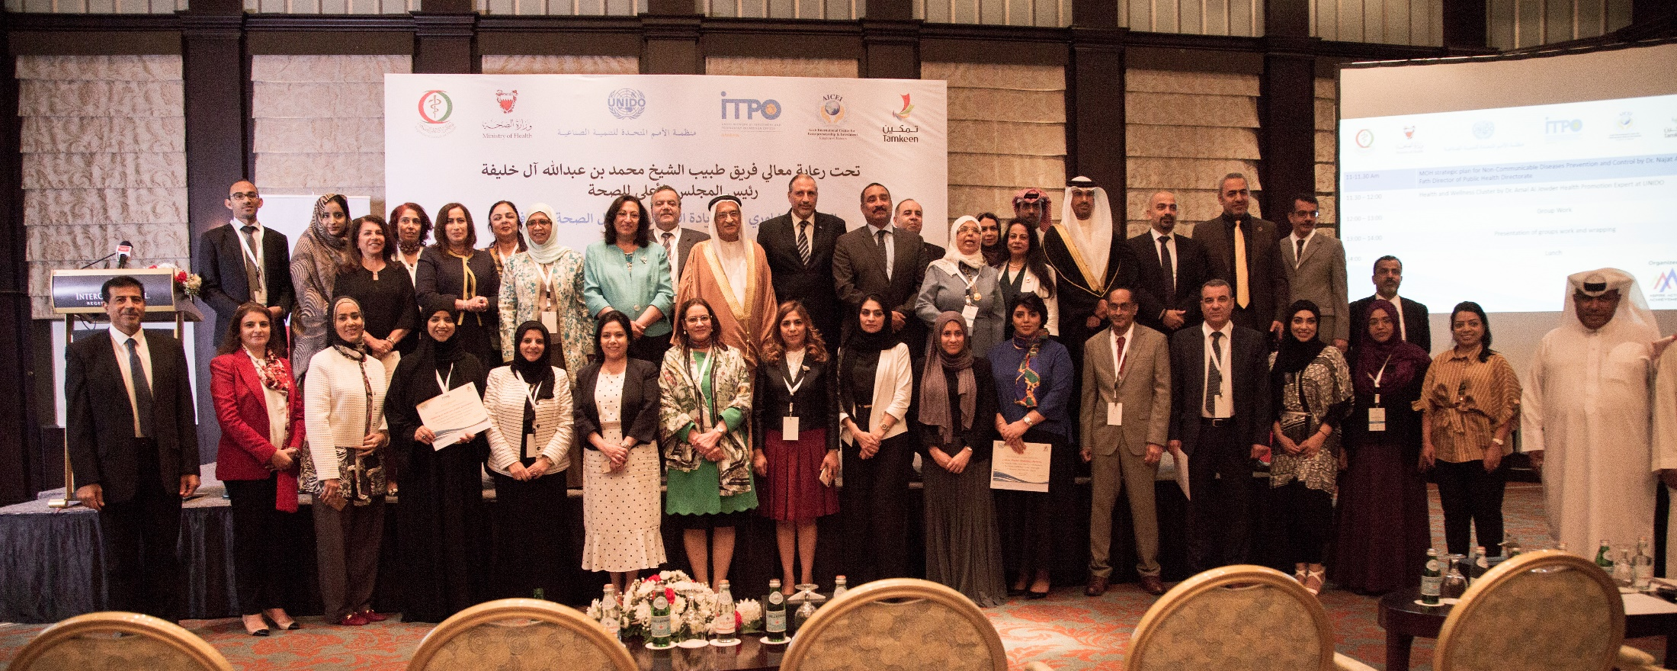
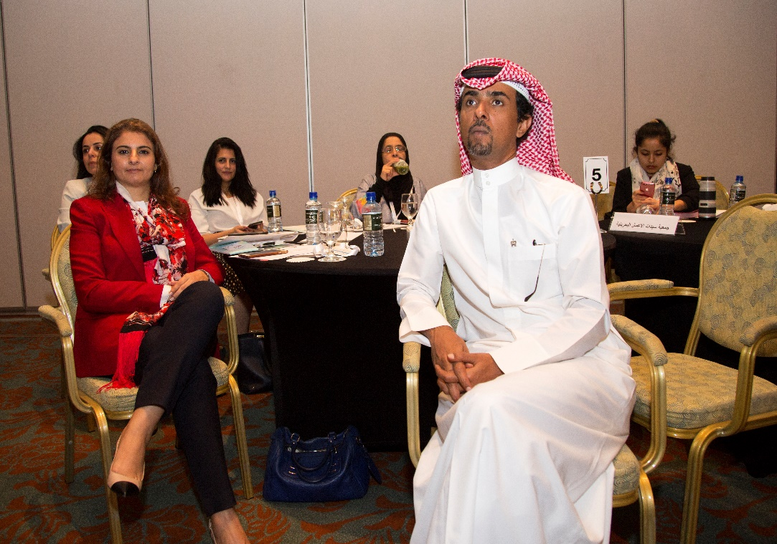

Slide 35
Health and Wellness Cluster project Logic Model

Slide 36
Indicators of success 1/2
Number of health awareness session (lecture, event, media
Number of H&W presentation held in ARCEIT Course
Number of health and wellness startup business

Slide 37
Number of Counseling session held for health and wellness Entrepreneurs
Indicators of success 2/2
Number of activities that introduced health and wellness to students and public (lecture, event, media…
Number of touch point with stakeholders and partners e.g. meeting, workshop, conference

Slide 38
Please follow us
@UNIDOBahrain
ajowder@unido.orgr

Slide 39
Thanks for your attention

