Slide 1
Marketing
Enterprise Development & Investment Promotion Program
UNIDO ITPO Bahrain / AICEI

Slide 2
Presentation Summary
Marketing
Defines the Marketing cycle
Case studies covering strong international brands
Different methods on marketing the same products
Importance of value marketing over price marketing

Slide 3
Incorrect Ideas on Marketing Myths & False Statements
Marketing is advertising (only)
Marketing can be done once business is running
Marketing plan can be addressed later
Marketing does not need a budget
Social media posts are considered enough

Slide 4
What is Marketing?
Understand
Engage
Identify
A Complete Cycle:
1. Market Identification
2. Market Understanding
3. Market Engagement
Strategy / Plan / Vision / Process
Target Market / Competitors / Economy
Research / Observation / Feedback
Marketing tools & approaches

Slide 5
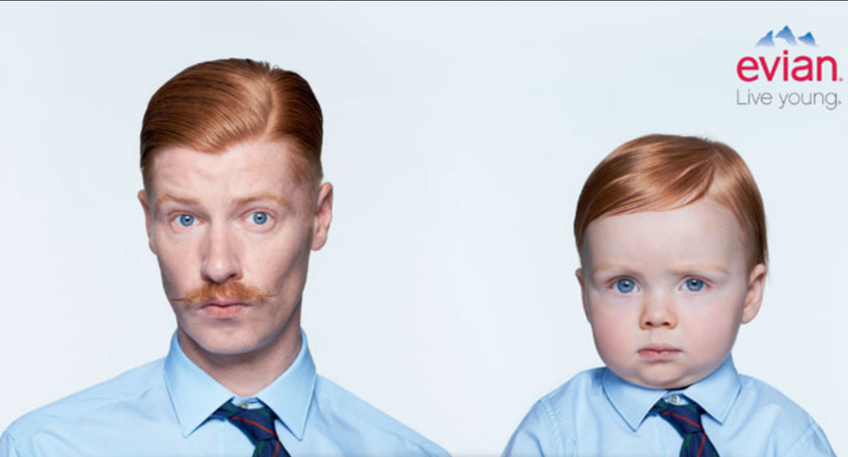
Case Study: Evian Water Bottles Source – Printed Media

Slide 6
Case Study: Evian Bottled Water Source – Printed Media
1. Identify
Middle aged / Seniors
Uncompromising
Focus on health & wellness
Educated
Professional / Employed
High purchasing power
2. Understand
Emotionally committed to health
No wavering / focus on habits
Associate Evian with the best health and quality
Investment in body
Health focus = less price sensitive
May have intrinsic worry over old age
Social status seekers / promoters
3. Engage
High price
Highlight images of baby health
Imply longer healthier life “live young”
Addresses underlying concern behind health worries
Innovative bottling/packaging
Available in most high end stores

Slide 7
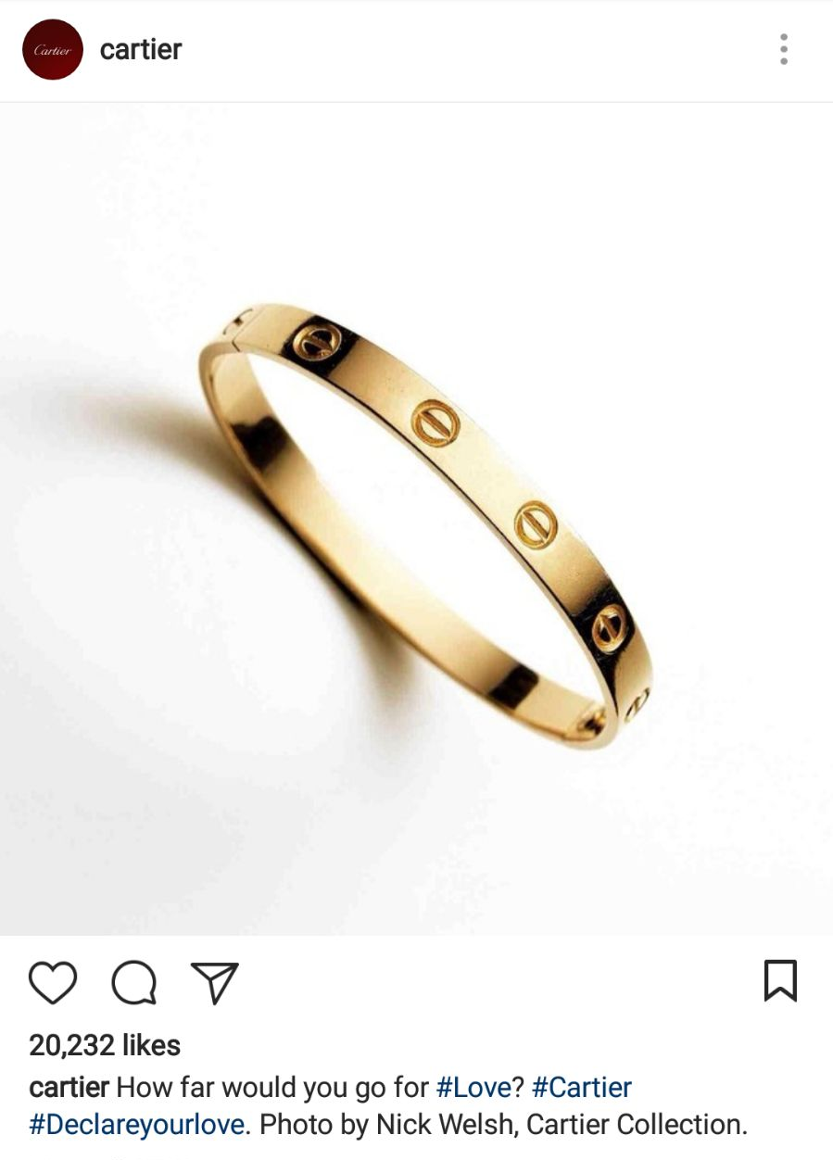
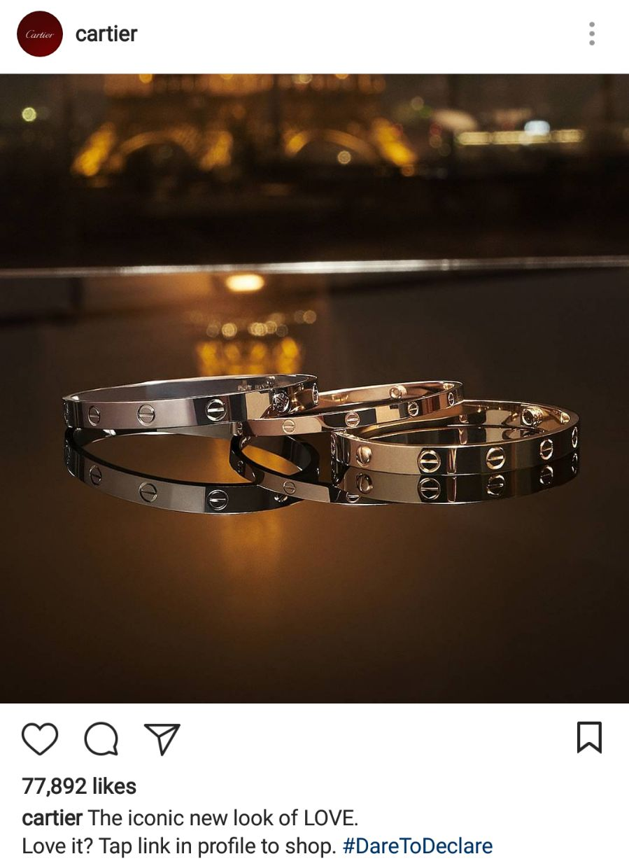
Case Study: Cartier Love Bracelet Source – Instagram

Slide 8
Case Study: Cartier Love Bracelet Source – Printed Media
1. Identify
Couples / Loved ones / Newly Married
Appreciate high end jewellery
Value the Cartier brand
Associate Cartier with certain values:
Classic, elegant, international, expensive
Educated
Brand conscious
Socially Active
Medium – High Income
Uncompromising
2. Understand
Purchasers :
Gift-givers
See value in brand as prestigious
See product as display of love
Exhibits generosity of buyer
Exhibits abundance of buyer
Less tied to product specifications
Less product literate
Users:
Sees product as display of love
End user influence on choice
End user encouraged to flaunt product
3. Engage
High / fixed / increasing prices
Excellent packaging
Fast/little interaction with customer
Variety of choices/colors
No marketing of product specs
Position product as “love bracelet”
Address end users with marketing
Utilize the brand name
Ultimately:
Infiltrate the diamong ring business.

Slide 9
Case Study: Rolex Luxury Watches Source – Online Advertisements

Slide 10
Case Study: Cartier Love Bracelet Source – Printed Media
1. Identify
Ambitious professionals
Gift givers
Social individuals
Appreciate high end watches
Medium – High Income
Associate Rolex with certain values:
Timeless, Royalty, Prestige, Success
Brand conscious
2. Understand
Consider watch a statement
Purchase of brand, not product
Less mechanically literate
Less product focused
More fashion conscious
Relate Rolex ownership with own
success / prestige / value
3. Engage
High / fixed / increasing prices
Excellent packaging
Don’t mention product specs
Associate brand with royal activities
Use classic advertising techniques
Avoids trends
Position itself as the “King”
of watches.

Slide 11
Various Methods on Marketing Differentiation / Innovation / Niche
You can market any product in a completely new way
Unique applications, distribution channels, and user experiences
Unique images, emotions, values, and inherent meaning
Unique positioning, pricing, packaging
Tailor-made / value-add to product...etc.

Slide 12
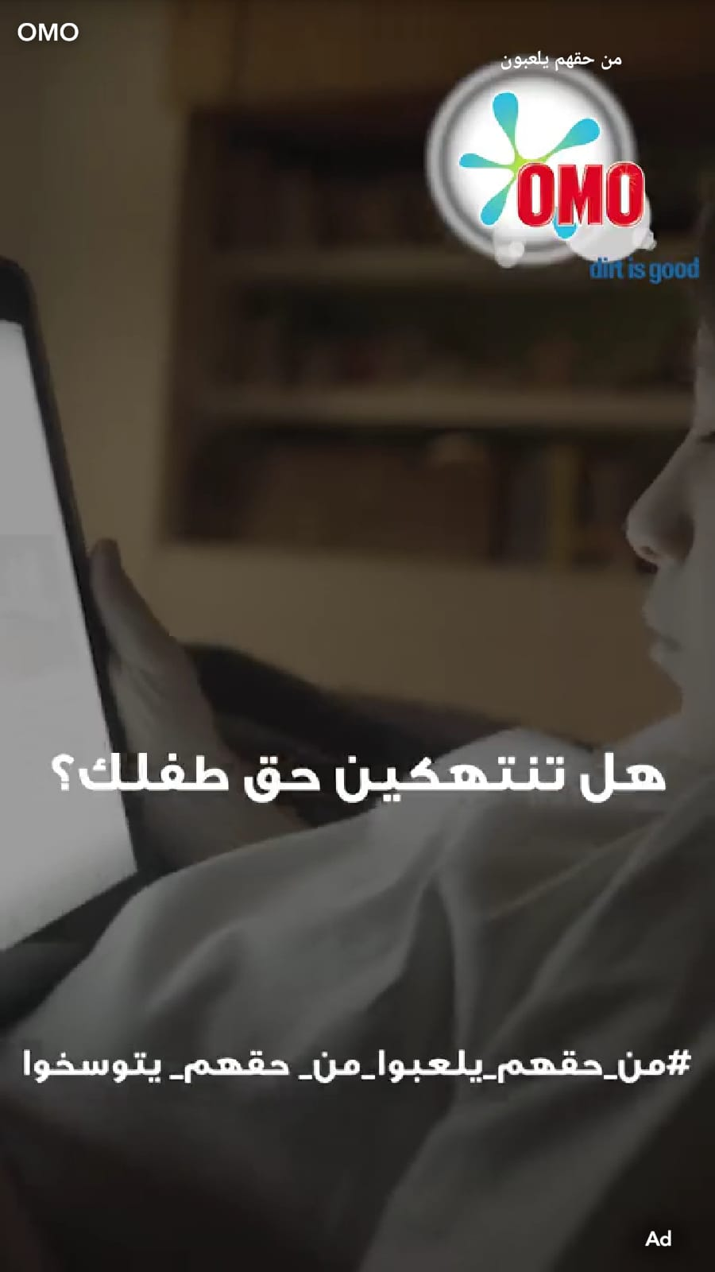
Similar Products, Different Approaches: Values Source - Snapchat

Slide 13
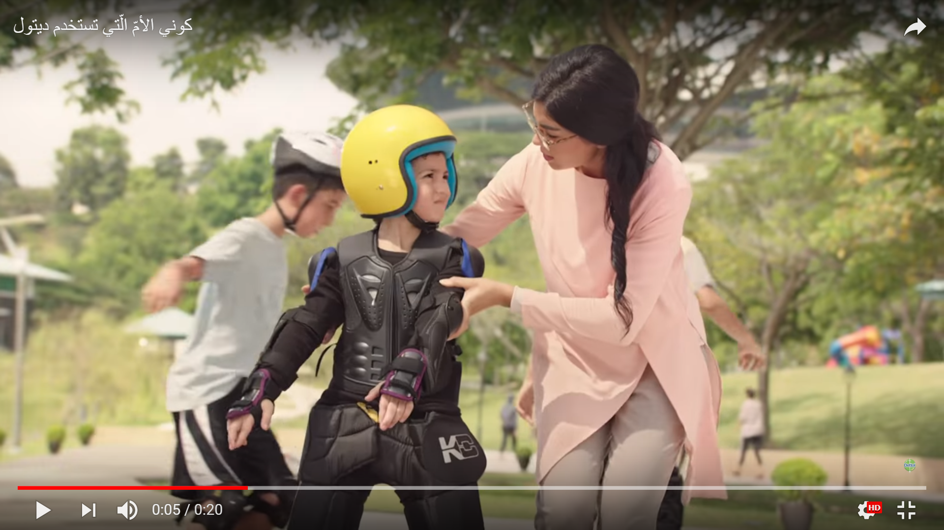
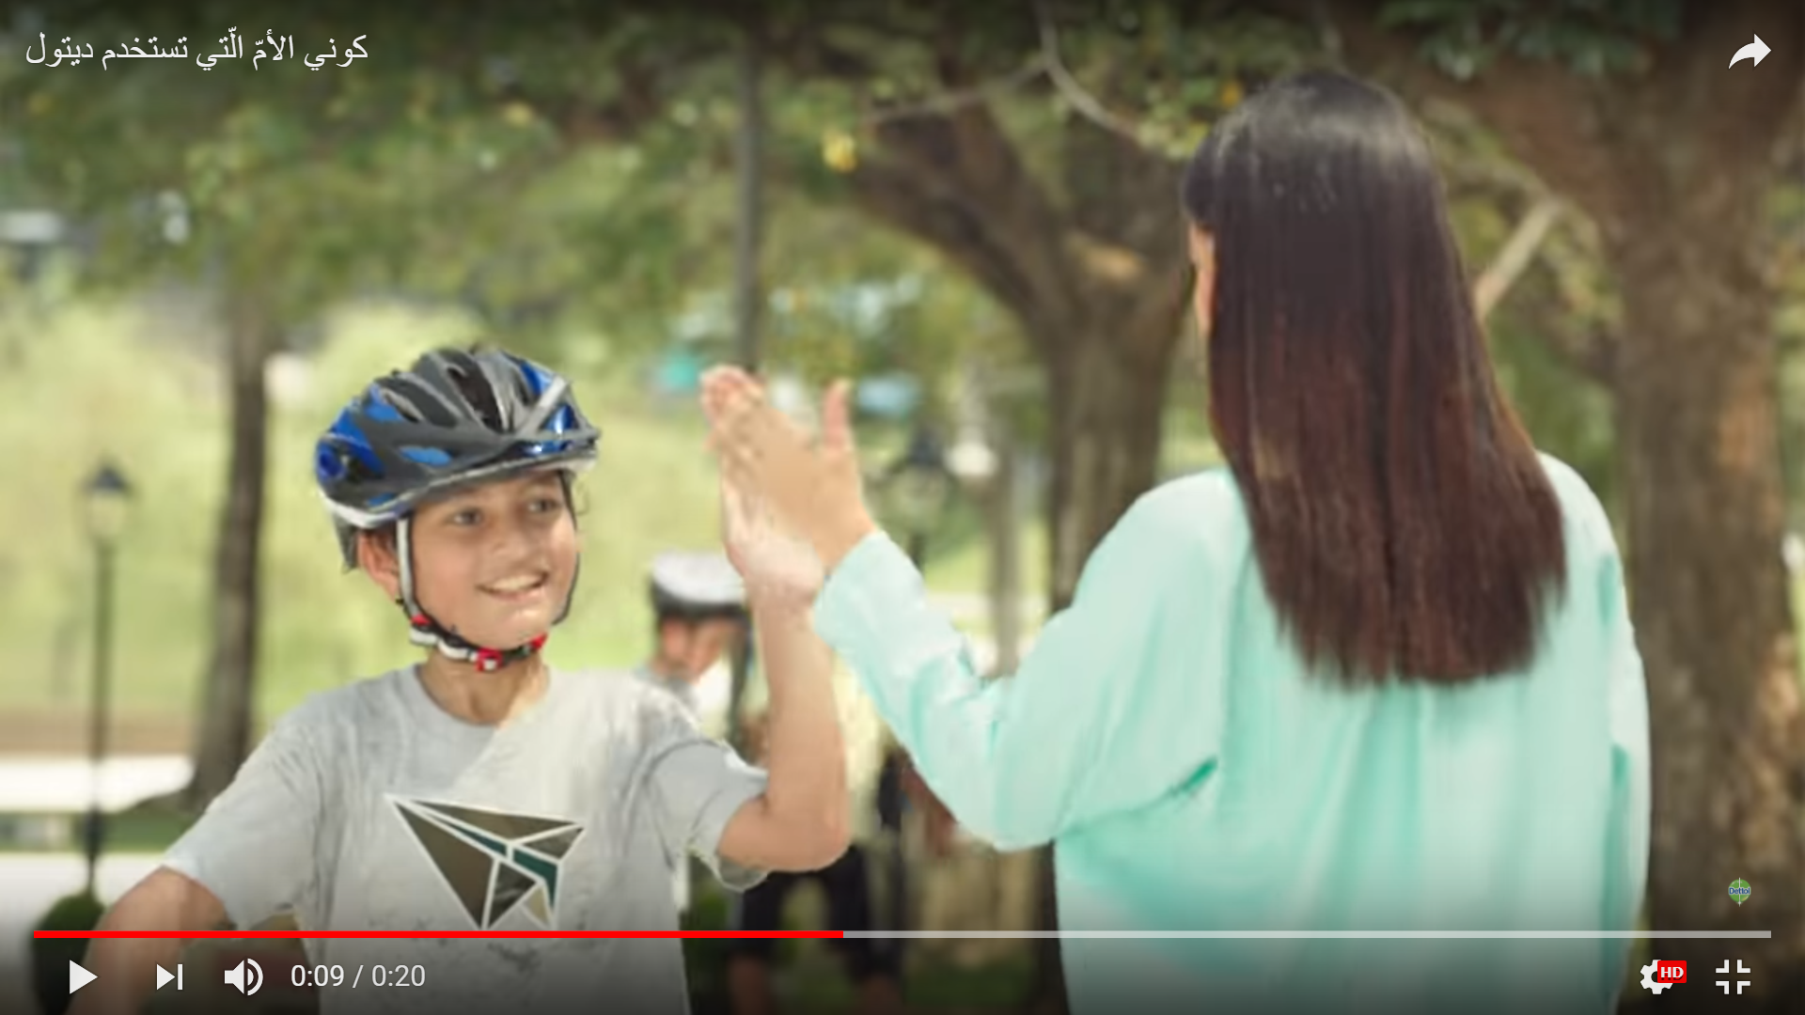
Similar Products, Different Approaches: Emotions Source – Youtube / TV

Slide 14
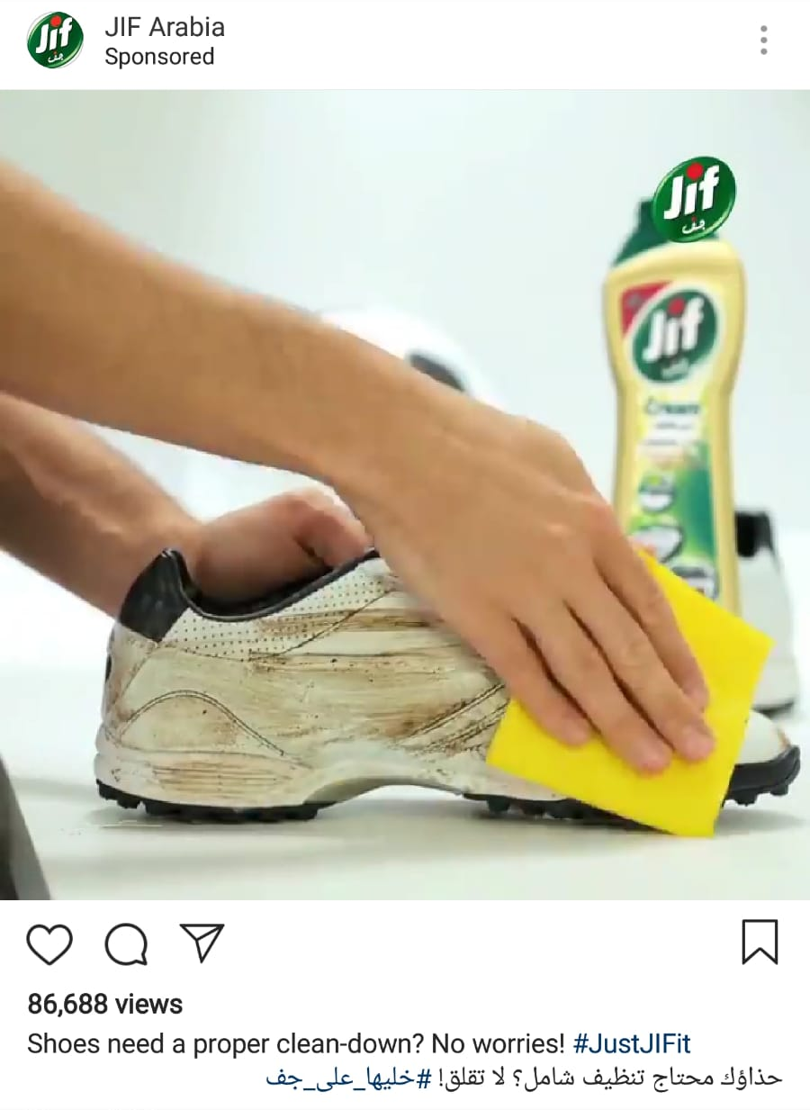
Similar Products, Different Approaches: Usage Source - Instagram

Slide 15
1. Identifying the Market
Demographics
Competitor Profiles
Market Share
General Economic Factors

Slide 16
Targeting the Right Demographic
gender race (ethnicity) age (date of birth) household income home ownership (length of residence, home size, mortgage) disabilities |  | education employment status children location type of car(s) marital status (head of household, spouse) savings, cd, 401k

Slide 17
2. Understanding the Market
Research
Observation
Feedback

Slide 18
3. Engaging with the Market
Tools
Approaches
Mediums

Slide 19
Marketing Tools
Instagram
Facebook
Google Search
Snapchat
Freebies
Word of Mouth
Banners
Signboards
Twitter
Publications
Lamp Posts
Partnerships

Slide 20
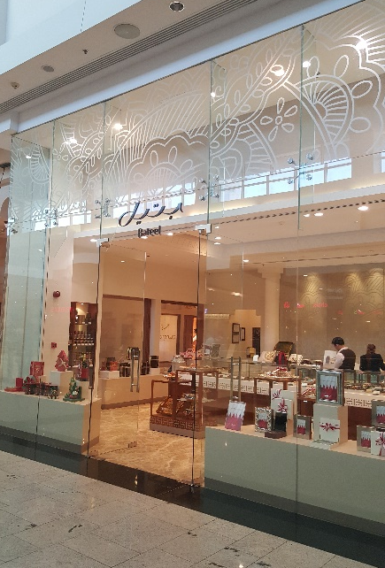
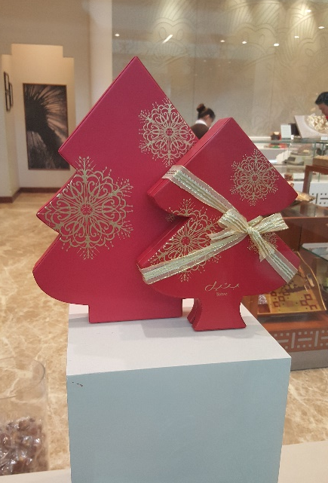
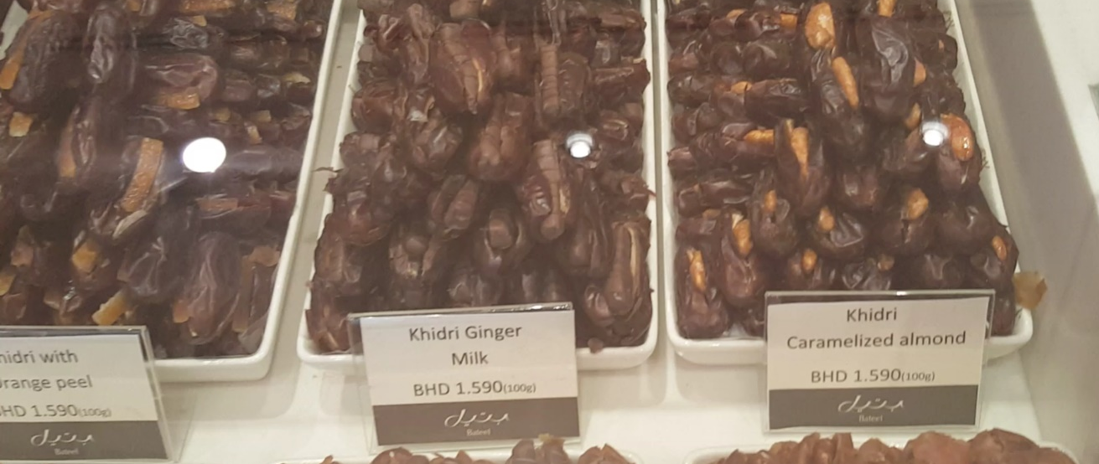
Successful Examples: Bateel
Marketed as a high end Arabic luxury sweet
Innovative recipes with quality Arabic dates
Focus on gift giving and quality packaging
Retail shop in City Center with exceptional standards
Positioned as a substitute for expensive chocolates
Targeting high income, tourist, and expat markets

Slide 21
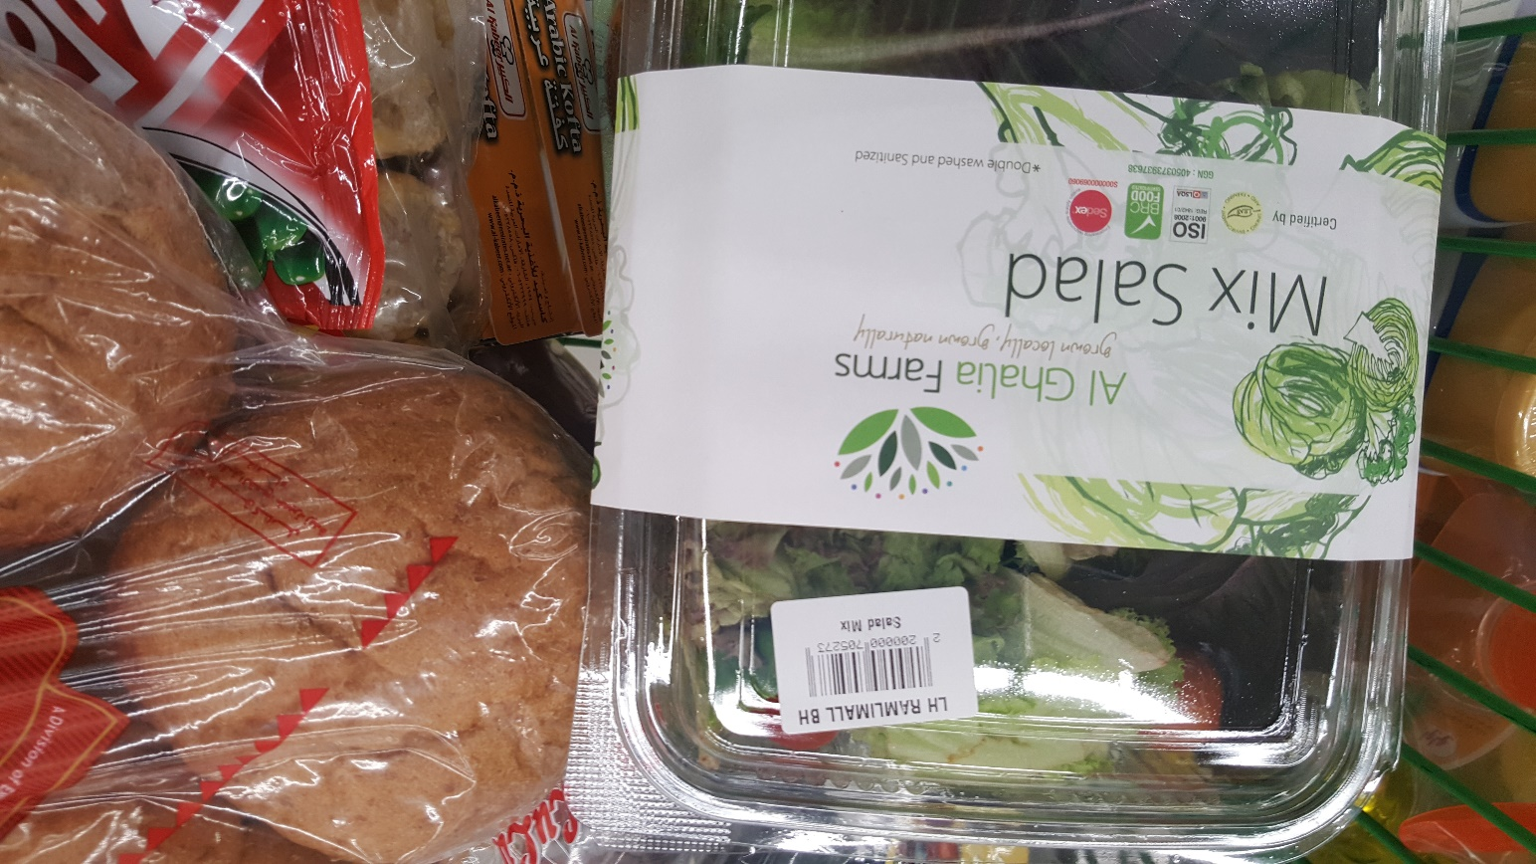
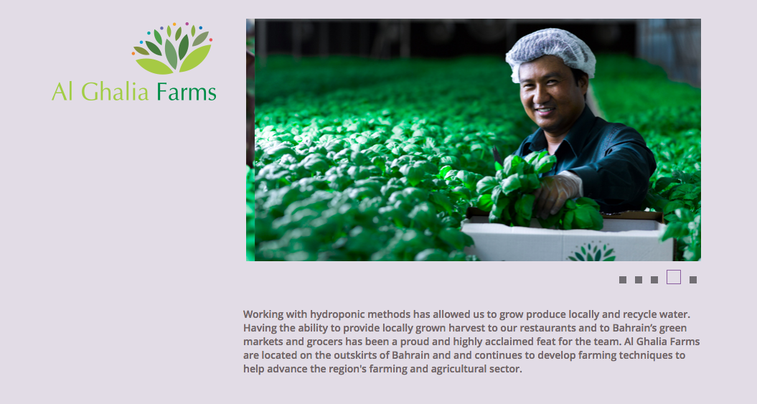
Successful Examples: AlGhalia Farms
Marketed as local “naturally grown” salad
Focus on creating international quality of branding
Focus on presenting quality and health certifications
Offer a ready made salad – value add
On display in hypermarkets

