Slide 1
THE LABOUR MARKET REGULATORY AUTHORITY

Slide 2
WHAT IS LMRA ???
The Authority in brief:
The Labour Market Regulatory Authority (LMRA) is a government body with a corporate identity that is endowed with full financial and administrative independence, under the authority of a board of directors duly chaired by the Minister of Labour.
His Majesty the king issued law on the 31st of May 2006 establishing the LMRA and mandated and ordained the LMRA to take over all the responsibilities
Pilot operational phase started in May 2007, serving the Public sector and selected private companies.
LMRA serves all private business sector’s (70,000+) for expatriate workers (500,000+)
LMRA has launched in Sept 2014 the public service for Domestic worker sector (40,000+)

Slide 3
LMRA SERVICES
All LMRA Procedures Are Done Under One Roof … As LMRA Works As A One transaction for a Number Of Government Entities ( IGA,NPRA (IMMGRATION), SIO, MOH, MOIC, MOL )
The LMRA as a central body will endeavor:
To issue work permits , resident permits and National ID cards (CPR) to enter the kingdom;
To process all applications and collect all fees related to permits and licenses issued under the law;
To carry out the necessary medical tests and other investigations for employers and expatriate worker in coordination with the concerned bodies; and
To perform labour market research and to design policies to be enforced and put in place in order to restructure the market, thus giving the LMRA the powers to carry out its mandate accordingly.

Slide 4
EMS
Expatriate Management system is one of a kind user interface in the gulf region , it is built up to connect a number of interfaces .
All LMRA services are done through a uniquely tailored Expatriate management system (EMS)

Slide 5
How are work permits processed?
TRANSACTION DETAILS – Stage A
SUBJECT |  | Step A | Step B | Step C | Step D | Step E
ATTAIN WORK PERMIT | TRANSACTION | LMRA | IGA | NPRA | LMRA | CLIENT
 | DETAILS | CUSTOMER APPLIES FOR WORK PERMIT AND LMRA VERFIERS WORKPERMIT DETAILS | ISSUE CPR NO. “ IDENTITY NUMBER” | ISSUE NON OBJECTION CERTIFICATE “ NON OBJECTION TO ENTER THE COUNTRY SECURITY CHECK IS PERFORMED” | WORK PERMIT IS ISSUED | PRINT WORK PERMIT

Slide 6
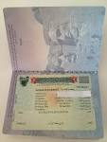
How are work permits processed?
TRANSACTION DETAILS – Stage B
SUBJECT |  | Step A | Step B | Step C | Step D | Step E | Step F
ATTAIN RESIDNCY PERMIT | TRANSACTION | ARRIVAL TO BAHRAIN | LMRA | TELECOMMUNICATIONS | NPRA | ISSUE MEDICAL APPOINTMENT | ISSUE RESIDENCY PERMIT
 | Details | EXPATRIATE ARRIVES TO BAHRAIN INTERNATIONAL AIRPORT | LMRA TAKES EXPATRIATE PERSONAL DATA | ISSUE SIM CARD “ TELEPHONE NO.” | NPRA TAKES EXPATRIATES BIO METRIC DATA “FINGER PRINTS | A MEDICAL APPOINTMENT DATE IS AUTOMATICALLY GENERATED | NPRA STAMP RESIDENCY PERMIT

Slide 7
How are work permits processed?
TRANSACTION DETAILS – Stage C
SUBJECT |  | Step A | Step B | Step C | Step D | Step E
PRE EMPLOYMENT CHECK UP | TRANSACTION | IGA | AL RAZI MEDICAL CENTER | MINISTRY OF HEALTH | LMRA | CLIENT
 | DETAILS | PRINT SMART CARD | ATTEND FOR MEDICAL TEST AT AUTHORIZED HEALTH CENTER | PASS TEST RESULTS TO LMRA | EXPATRIATE FITNESS IS REGISTERED IN EMS UNFIT EXPATRIATES ARE ARRANGED TO BE DEPORTED | CLIENT TERMINATES AND DEPORTS UNFIT EXPATRIATE

Slide 8
A UNIQUE TOUCH
A UNIQUE TOUCH TO SERVICES
LMRA provides a unique touch to services as it offers PAPER- LESS Online services.
99.8 % of LMRA transaction services are performed online
All online services are linked to spokes (IGA,NPRA,MOIC,MOL,MOH,SIO) – “ there is no requirement to move around town to complete the an employment transaction”
LMRA has developed an electronic support system since 2009 to answer and resolve customer enquires
99.6 % of customer enquires and issues are resolved online

Slide 9
SERVICE LEVEL AGREEMENT
All LMRA and spokes related transactions have a targeted SLA period, set as below
ENTITY | SLA DAYS | SLA ACHIEVMENTS *
LMRA | 3 DAYS | 98%
IGA | 2 DAYS | 99%
NPRA | 5 DAYS | 92%
TOTAL | 10 DAYS | 96%
LMRA was able to complete 98 % of its applications in the period of its 3 days target
LMRA was able to issue 96 % of its submitted applications in the 10 days target as per SLA agreements with spokes

Slide 10
LMRA SERVICE CHANNELS
LMRA provides its services through
LMRA COUNTERS | CALL CENTER

Slide 11
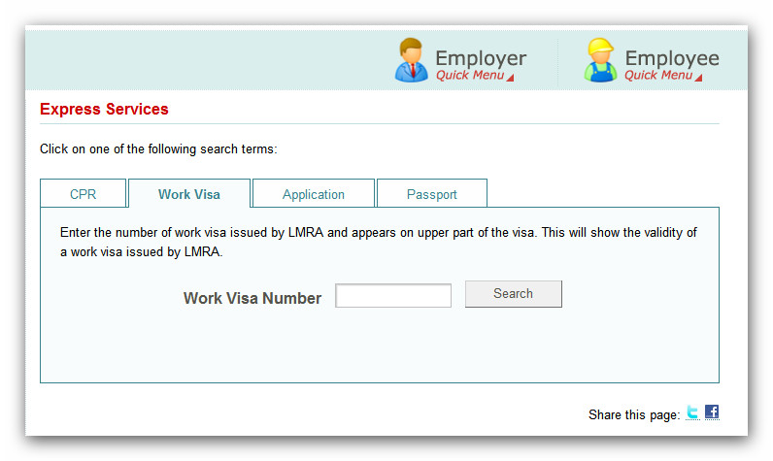
LMRA SERVICE CHANNELS
Expatriate Portal | Express Services

Slide 12
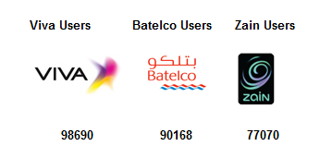
LMRA SERVICE CHANNELS
SMS SERVICES | MOBILE SITE

Slide 13
LMRA SERVICE CHANNELS
CLIENTS E-SUPPORT CENTER | LMRA EMAIL

Slide 14
LMRA TRANSACTION FEES
Act no. (19) (2006) has mandated LMRA to collect certain fees from employers of foreign employees.
LMRA FEES | EXPATRIATE | DEPENDENT | PERIOD
NEW WORK PERMIT | 200 BD | 90 BD | 2 YEARS
 | 100 BD | 90 BD | 1 YEAR
RENEWAL | 200 BD | 90 BD | 2 YEARS
 | 100 BD | 90 BD | 1 YEAR
 | 50 BD | 90 BD | 6 MONTHS
NEW WORK PERMIT- DOMESTIC | 35 BD | NIL | 6 MONTHS
RENEWAL - DOMESTIC | 45 BD | NIL | 6 MONTHS
MOBILITY | 200 BD | 90 BD | 2 YEARS
CHANGE OF OCCUPATION | 10 BD | NIL | ONE TIME
MONTHLY FEES | 5 BD – OLDEST 5 WORK PERMIT 10 BD – 6TH EXPATRIATE ABOVE | NIL | MONTHLY
LMRA transfers all the collected fees as follows
80 % goes to the Labour Fund – Tamkeen and 20 % goes to the Ministry of Finance

Slide 15
THANK YOU
Contacts: T: 17 50 60 55- call center email: lmra@lmra.gov.bh
Support: www.lmra.bh/esupport

