Slide 1
UNIDO Bahrain
Investment & Technology Promotion Office
Arab International Center for Entrepreneurship & Investment

Slide 2
UNIDO Summary
UNIDO
UNIDO
Established in 1966
Specialized agency since 1985
Includes 169 member countries
ITPO Bahrain
Established in 1996
Representative
Offices
35
ITPOs
12
Cleaner
Production Centers
30
Technology
Centers
15

Slide 3
UNIDO Functions
Global Forum
Generates & disseminates knowledge relating to industrial matters
Enhance cooperation
Establish dialogue
Develop partnerships
Tailor-made specialized support
Technical Cooperation:
Design & implement programs (tailor-made) to support industrial developlment

Slide 4
UNIDO Services
Providing professional support to enterprises for partnership and business negotiations
ITPOs guide potential investors from their host countries and from developing countries at each stage of the investment cycle, from project identification through appraisal to implementation.
ITPOs offer validated investment opportunities, including manufacturing facilities, and technology supply sources.
ITPOs provide first-hand knowledge on how to do business in local environments.
Operating the Delegate programme for investment and technology promotion
ITPOs host officials from developing countries and economies in transition to give them hands-on training in investment promotion techniques so that delegates are able to promote portfolios of screened investment and technology opportunities from their own countries.

Slide 5
UNIDO Services
Industrial Governance & Statistics
Investment & Technology Promotion
Quality & Productivity
Small Business Development
Environmental Management
Industrial Energy & Kyoto Protocol (Climate change)
Montreal Protocol (ODS)
Agro-Industries

Slide 6
UNIDO Tools
COMFAR III Expert: An application developed by UNIDO for the analysis and appraisal of investment projects of any kind.
Pharos: A comprehensive PC software package for measuring, monitoring and benchmarking strategic business performance of enterprises.
Company Project Profile: UNIDO software devised to facilitate the formulation of standardized investment projects in preparation of their screening and subsequent promotion.
Enterprise Development & Investment Promotion (EDIP) Program: Implemented in over 50 countries - A package approach aimed at promoting foreign direct investment through the facilitation of domestic investment
National Cleaner Production Centers: Centers aiming at building cleaner national production capacities.

Slide 7
UNIDO Tools (cont‘d)
Subcontracting and Partnership Exchanges: (44 SPXs in 32 countries) specialized centers for technical information, promotion and the matching of capacities, processes and production or industrial service specialities, in the form of an autonomous structure whose basic purpose is to help bring together enquiries for and offers of subcontracting work and outsourcing.”
Export Consortia: A voluntary alliance of firms with the objective of promoting the export of goods and services of its members through joint actions.

Slide 8
Sustainable Development Goals
UNIDO is fully committed to contributing to the achievement of the SDGs, while delivering on its mandate to support Member States in achieving inclusive and sustainable industrial development (ISID).
Seeks to advance poverty eradication and inclusiveness, build productive capacities in an inclusive manner, and provide more opportunities for all women and men as well as across social groups, also through partnerships with all stakeholders involved in industrialization processes
Promotes rapid economic and industrial growth, builds trade capacities in industries, and ensures that all countries can benefit from international trade and technological progress, also through the application of modern industrial policies and compliance with global standards and norms
Aims to advance environmentally sustainable growth, builds institutional capacities for greening industries through cleaner production technologies and resource efficiency methodologies, and creates green industries, spurred by technology facilitation, innovation and partnership building

Slide 9
ITPO Network Investment & Technology Promotion Offices
UNIDO
ITPO Network
Mission & Mandate
UNIDO ITPOs have contributed to reducing development imbalances, by brokering investment and technology agreements between developed, developing countries and countries with economies in transition.
Network of UNIDO ITPOs opens up opportunities for investors and technology suppliers to find potential partners and offers unique services to both entrepreneurs and business institutions.
ITPO
Bahrain

Slide 10
ITPO Network Investment & Technology Promotion Offices
RUSSIAN FEDERATION- Moscow
GERMANY
ITALY-Rome
CHINA- Beijing
JAPAN-Tokyo
BAHRAIN
NIGERIA

Slide 11
ITPO Services
Providing professional support to enterprises for partnership and business negotiations
ITPOs guide potential investors from their host countries and from developing countries at each stage of the investment cycle, from project identification through appraisal to implementation.
ITPOs offer validated investment opportunities, including manufacturing facilities, and technology supply sources.
ITPOs provide first-hand knowledge on how to do business in local environments.
Operating the Delegate programme for investment and technology promotion
ITPOs host officials from developing countries and economies in transition to give them hands-on training in investment promotion techniques so that delegates are able to promote portfolios of screened investment and technology opportunities from their own countries.

Slide 12
Arab International Center for Entrepreneurship & Investment
Services:
Facilitate new enterprise creation / Assist in starting your own business
Develop / assist you in attracting partners & establishing joint ventures
Providing specialized programs for growth & reaching export markets
Enhance the competitiveness of existing enterprises / Enterprise Upgrading
Facilitate the creation of a conducive business environment for the emergence, sustainability and growth of SMEs

Slide 13
Programs towards Entrepreneurship & Capacity Development
Arab International Center for Entrepreneurship & Investment
Institutional Level
Training of trainers for “Entrepreneurship Development & Enterprise Creation Program”
Developing Resource Persons for Enterprise Growth
Strategic and Production Management of Industrial Enterprises
Industrial Project Identification, Preparation and Appraisal
Entrepreneurial Level
Enterprise Creation Program
Technology Management
Quality Management
Control Management Systems

Slide 14
Enterprise Development & Investment Promotion Program “Bahrain Model of Entrepreneurship“

Slide 15
EDIP Summary
EDIP Program:
Developmental program to support the start-up and growth of Micro, Small, and Medium Sized Enterprises (MSMEs) through financial and non-financial services.
Conceptualized in Bahrain in 1999
Currently implemented in 52 countries
Package approach encompassing 3 key stages aimed at developing the capacities of potential investors/entrepreneurs
Holistic approach that deals with building entrepreneurial capabilities in addition to enterprise planning, implementation and management.

Slide 16
EDIP Summary (cont‘d)
EDIP Accolades:
The model has achieved major successes which led in 2007 the United Nations Industrial Development Organization (UNIDO) to adopt it officially.
In 2009, it was named as the best program towards the economic empowerment of youth and women with in the United Nations System.
In 2017, His Excellency Mr. Antonio Guterres, the Secretary General of the United Nations, acknowledged and applauded the program, stating that “the so-called Bahrain model has created more than 16,000 jobs and raised more than $2 billion in investment. Today, in 52 countries, it continues to advance entrepreneurship and change lives for the better.”

Slide 17
EDIP Premise
Regional Obstacles – indicated by economic research:
Job seekers in the Arab world is projected to soar to 95 million by 2030
“Youth Bulge” - more than half of population under 25 years old
World’s highest regional youth unemployment rate
High rates of unemployment and under-employment
Decreasing shares of public sector employment
Weak Entrepreneurship culture
The in-existence of specialized programs on entrepreneurship development, and support for micro, small & medium enterprises (MSMEs)
Limited support institutions targeting entrepreneurs in the areas of training, technology, finance and incubation

Slide 18
EDIP Premise (cont‘d)
Regional need for:
The development of national specialized programs aimed at creating awareness and stimulating economic empowerment for Arab entrepreneurs
The adoption of programs geared towards entrepreneurship and MSME development and that have proven their effectiveness
Provide counseling programs aimed at facilitating enterprises growth
Developing linkages between financial institutions and entrepreneurship programs
The establishment of business incubators as they play a key role in the development and growth of MSMEs through a range of services offered

Slide 19
EDIP Program Methodology

Slide 20
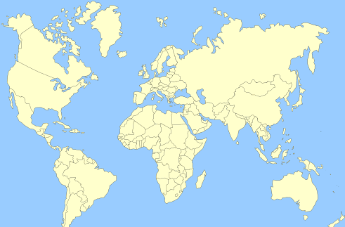
Kazakhstan
Tunisia
Turkey
Azerbaijan
Algeria
Cyprus
Syria
Turkmenistan
Lebanon
Iraq
Afghanistan
China
Morocco
Jordan
Kuwait
Pakistan
Palestine
Bahrain
Egypt
Saudi Arabia
United Arab Emirates
Mali
Niger
Oman
India
Laos
Senegal
Burkina Faso
Yemen
Thailand
Guinea-Bissau
Guinea
Sudan
Eretria
Sierra Leone
Benin
Ethiopia
Liberia
Togo
Brunei
Ivory Coast
Ghana
Uganda
Kenya
Tanzania
Zanzibar
Zambia
Mozambique
Uruguay

Slide 21
Pre - Incubation
Step 1: Preparation & Empowerment
“Entrepreneurs are not only born but can be trained, developed and empowered” to acquire confidence and scientific calculated risk in implementing their business
The training process is result-oriented, the potential entrepreneur is expected to set-up his own business enterprise appropriate to his abilities
Inputs on:
Setting up a small enterprise (rules, procedures, formalities)
Business opportunity identification (screening, firming-up)
Market assessment
Entrepreneurial competencies (strengthening soft skills)
Business plan preparation
Essentials of managing a small enterprise
Inputs on how to implement a project

Slide 22
Pre - Incubation
Step 2: Counseling & Technology Tie – up
Leading to a Full Fledged JV
Assisting In:
Finalizing their business ideas
Developing their own business plans
The process of project implementation
Technology tie-ups
Business partnerships (Joint Venture collaborations)
Seeking necessary licenses and completing legal documentation
The duration of this process depends on the needs of the respective entrepreneur as identified by the business counselor and the entrepreneur

Slide 23
Pre - Incubation
Step 3: Financial Linkages
Appropriate financial linkages is identified based on project requirements and entrepreneur investment capability
Need based advice and support is provided by the financial counselor
Guidance given on sources of financial support, including institutions, associations, councils, investors and others.
“Venture Capital Fund for Selected Arab Countries” established in cooperation with the Kuwait Finance House

Slide 24
Incubation
Step 4: Virtual or In-wall Incubation
Essential linkages are facilitated with institutions dealing with infrastructure operators
Guidance and support on issues related to procurement, installation and commissioning
Business Counselor and Financial Counselor closely monitor the project implementation process
Virtual or Out-wall Incubation
In-wall Incubation
Projects requiring basic infrastructure services offered by the business incubator and are found suitable, are selected and facilitated to operate from the incubator

Slide 25
Post Incubation
Step 5: Growth Initiatives
Mentoring
Technical Support/Administrative:
Access to information and data / Developing growth business plans
Business Counseling, Co-entrepreneurship & Angels Program
Technology upgrading: Raw materials sourcing , sourcing of technology
Quality management & upgrading to ensure adherence to international markets
Legal support
Access to New Markets:
Franchising
Clusters
Export Consortia
Subcontracting exchanges

Slide 26
Post Incubation (cont’d)
Step 5: Growth Initiatives
Financial Support
Medium to large financing
Seed capital
Equity & Venture Capital Funds
Infrastructure
Sector specific Incubators
Technology Parks
Research & development facilities

Slide 27
Post Incubation (cont’d)
Step 5: Growth Initiatives
Financial Support
Medium to large financing
Seed capital
Equity & Venture Capital Funds
Infrastructure
Sector specific Incubators
Technology Parks
Research & development facilities

Slide 28
Business Growth Cycle & Assistance Schemes
M
A
TUR
I
T
Y
L
E
V
E
L
Maturity
Expansion
Growth
Start up
TIME
Schemes
EDIP for Start-up & Micro Entrepreneurs
Innovation Entrepr.
Pre-Start-up awareness campaigns with Schools, Universities, Educational Intuitions, NGOs & Media
EDIP Growth Services
EDIP growth services to existing SMEs
Linkages and networking with foreign Investors (FDI)

Slide 29
Enterprise Development & Investment Promotion
Program Network
Bahrain
Business
Women
Society
Ministry of
Industry &
Commerce
TAMKEEN
Bahrain
Chamber of
Commerce
& Industry
University
Of
Bahrain
Bahrain
Business
Incubator
Center
Entrepreneur
UNIDO
Economic
Development
Board
Ministry of
Culture
Specialized
Resources
Persons
ARCEIT
Bahrain
Development
Bank
Bahrain
Young
Entrepreneurs
Association
PMEW
Ebdaa Bank
Ministry of
Municipalities
& Urban
Planning
Media
Partners
Kuwait
Finance
House
National
Initiative
Agricultural
Development

Slide 30
Partnerships

Slide 31
Sample Non Government Organization Partners
Intel Foundation
Association of Women Entrepreneurs
Federation of Indian Women Entrepreneurs
Bahrain Businesswomen's Society
African Business Women Association
Arab Businesswomen Council
International Women Entrepreneurial Challenge
International Federation of Business Professionals
Emirates Businesswomen Council
Bahrain Supreme Council for Women
Egyptian Business Women Association
International SME Network
Global Entrepreneurship Week
Family Development Foundation

Slide 32
Financial Partnerships and Alliances
Arab Bank for Economic Development in Africa
Sponsored the implementation of the EDIP modality into Ghana, Kenya, Sierra Leone, Uganda, Tanzania, Zanzibar, Eretria, Ethiopia and Zambia
BADEA was also the main sponsor to “International Entrepreneurs Investment Forum” 2015.
ITPO Bahrain has recently finalized in cooperation with BADEA a three-year joint program towards the enhancement of the private sector in Africa based on the EDIP Modality; through which women economic empowerment is a major component.
Biggest sponsor of the Women Panel as part of the UNIDO 50th Anniversary
Islamic Development Bank
Has been a strong supporter and funding source for many of the programs and initiatives implemented by ITPO Bahrain examples include Development of the Agro-Preneurs Growth Pole in Bahrain.
Jointly developed the three-year work plan for the Islamic Development Bank ITAP (Investment and technical Assistance Program)
Currently working with the IDB in developing a 50 million USD “youth employment fund”

Slide 33
Financial Partnerships and Alliances
Kuwait Fund for Development
Managed through a special arrangement to secure 50 million USD fund to the Bahrain Development Bank.
Established the Bahrain Business Incubator Center
Arab Gulf Program for Development
Supported the establishment of the Bank of Innovations in in Bahrain, Sierra Leone, Jordan, Lebanon, Syria, Egypt, Sudan and Yemen with special focus on women. To support the Move from the informal to the formal sector.
Non-Financial Services Units
Developed non-financial services units/centers towards entrepreneurship with various financial institutions; namely, Bahrain Development Bank (Bahrain), TAMKEEN (Bahrain SME Fund), Bank Al Khartoum (Sudan), Kuwait Finance House, Family Bank (Sudan), Social Fund for Development (Egypt), Khalifa Fund for Development (UAE), Centennial Fund for SME Development (Saudi Arabia), Alexandria Businessmen Association (Egypt), Accounting and Auditing Organization for Islamic Financial Institutions (regional), Fransabank (Lebanon)

Slide 34
Financial Partnerships and Alliances
Maritime – Continental Silk Road Initiative (MCSR)
As part of the MCSR initiatives and programs ITPO Bahrain spear headed the initiation of the MCSR Entrepreneurs Alliance which is hosted at its premises in Bahrain.
UNIDO Intel Virtual Entrepreneurship & Innovation Hub
Intel co-development in cooperation with ITPO Bahrain the Virtual Hub, based on the EDIP Modality; which aims at closing the digital gender divide as well as at fostering economic growth and innovation
Investing in Women and Girls Series
As part of the UN SG Mr. Ban Ki-moon’s initiative on Investing in Women and Girls; ITPO Bahrain is launching the first edition of the Booklet “Investing in Women and Girls” which features 16 ladies from nine countries and who have been economically empowered by the EDIP Program.
World Free Zone Organization
ITPO Bahrain recently finalized a comprehensive strategy for Future Free Zones which includes a holistic approach to the development of economic zones thus entailing the stimulation of entrepreneurship and innovation and creating value chains for existing SMEs.
BADEA - Arab Union for Industrial Exports Development
ITPO Bahrain in cooperation with our partners are organizing the Arab-African Conference & Exhibition on Industrial Products for Businesswomen in Egypt on November 2 to 5. Currently work has been initiated with BADEA on developing specialized programs aimed at stimulating women into industry.
Creative Women
Launched the creative women entrepreneurs initiative in Matera for the countries of the Mediterranean

Slide 35
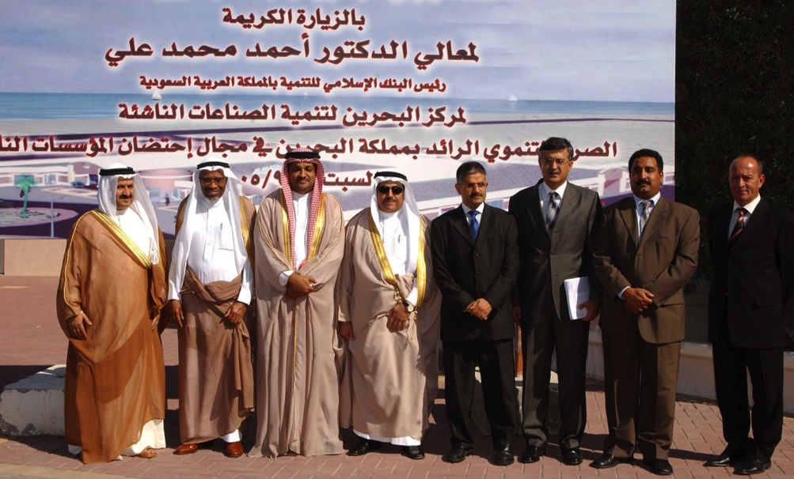
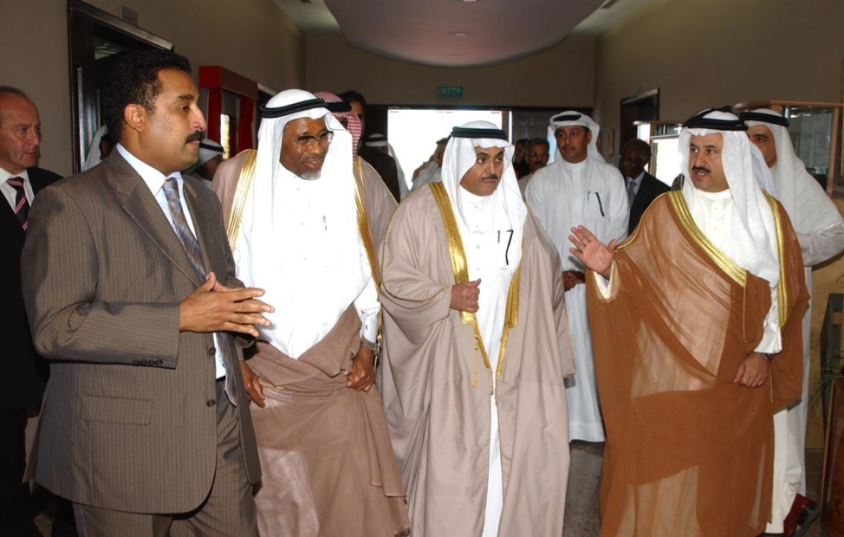
H.E. Dr. Ahmad Mohamad Ali, Chairman Islamic Development Bank, 2005
Testimonials

Slide 36
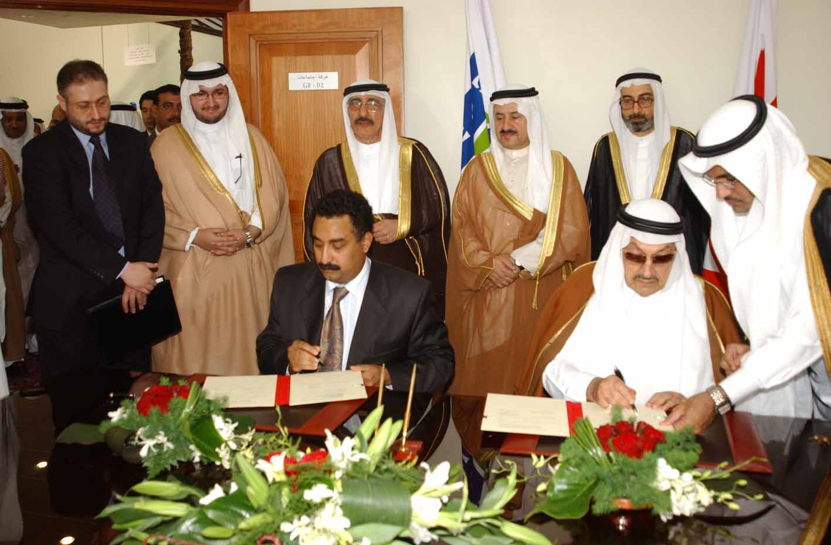
His Royal Highness Prince Talal Bin Abdul Aziz signing a working arrangement with ARCEIT, 2006

Slide 37
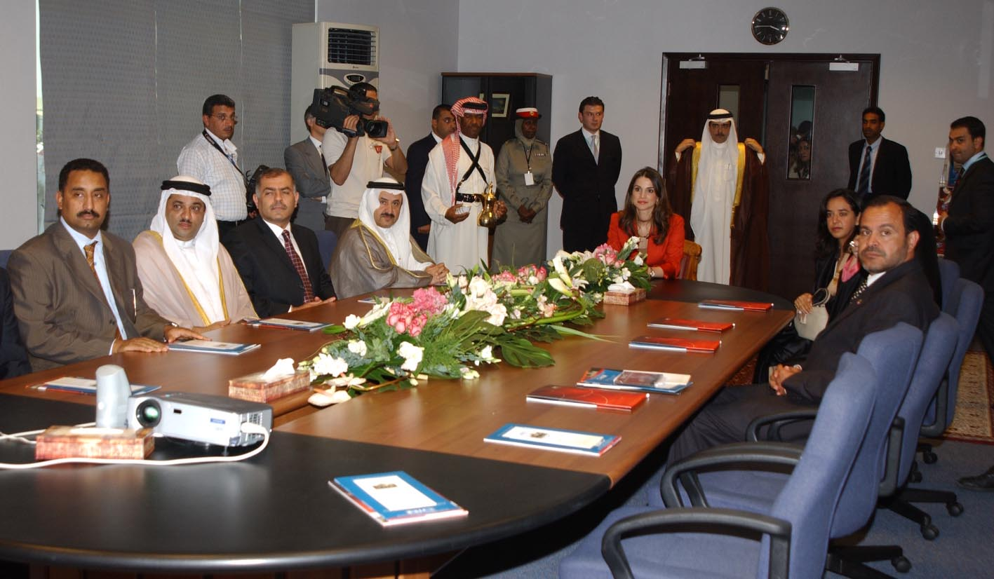
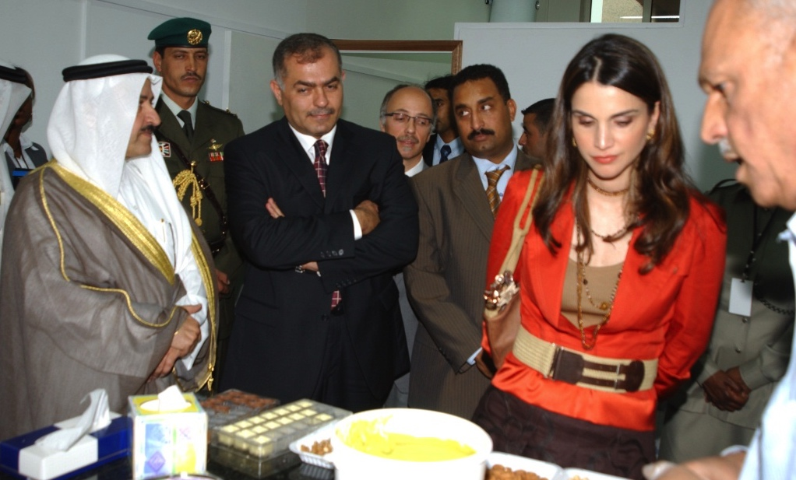
Her Majesty Queen Rania Al Abdulla visits the Bahrain Business Incubator Center

Slide 38
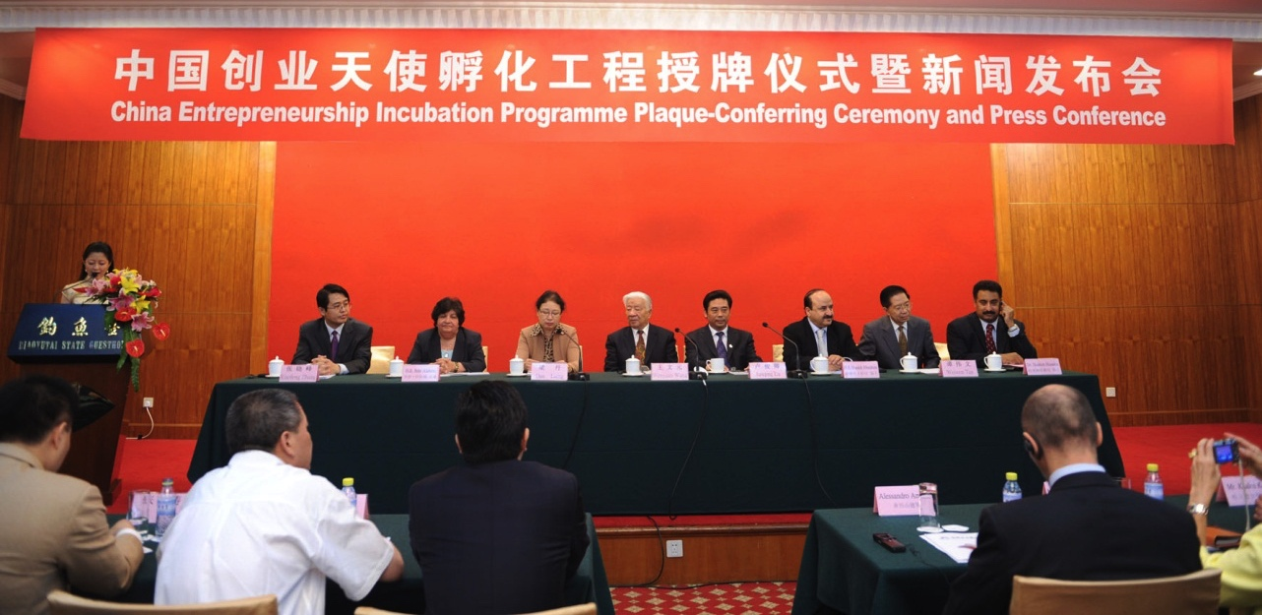
Launching the EDIP in China

Slide 39
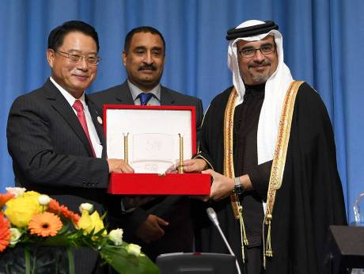
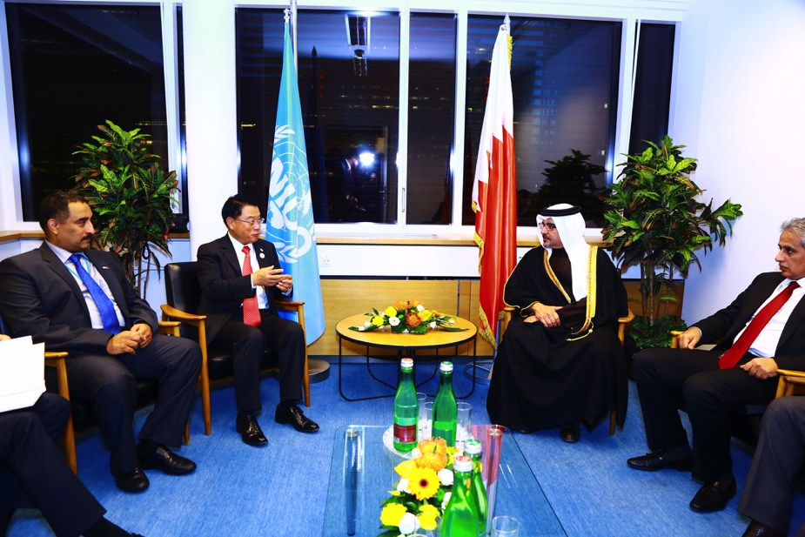
UNIDO 50th Anniversary Expo 2016, Vienna UNIDO ITPO Bahrain 20th Anniversary
Focus on Bahrain: Acknowledgment and the awarding of His Royal Majesty for his global role towards economic empowerment of youth and women through the Bahrain Model for Entrepreneurship.
This award highlights ITPO Bahrain’s achievement in creating and implementing the Bahrain Model in over 48 countries and supporting millions of entrepreneurs around the globe.

Slide 40
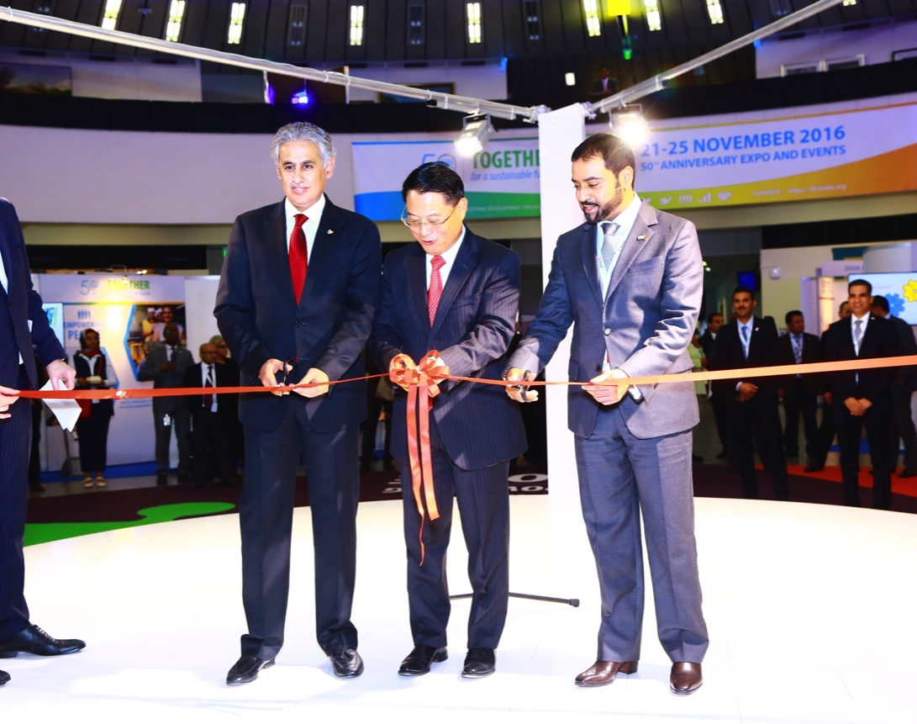
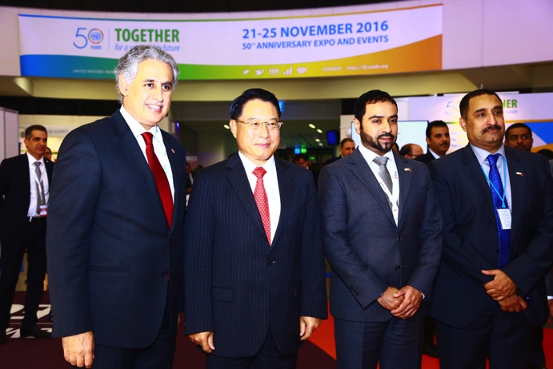
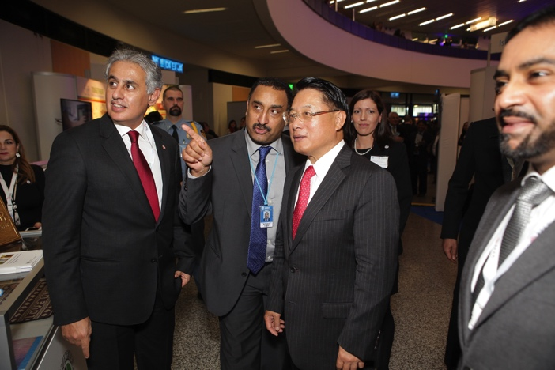
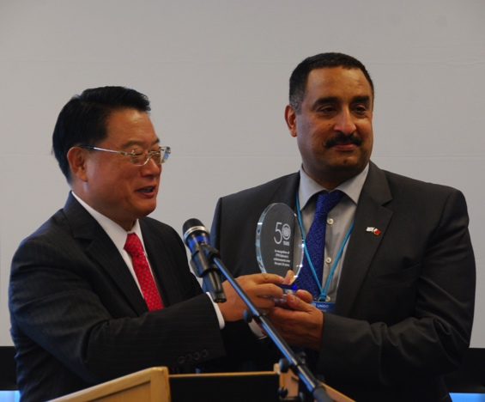
UNIDO 50th Anniversary Expo 2016, Vienna UNIDO ITPO Bahrain 20th Anniversary
H.E. Shaikh Faisal Bin Rashid Al Khalifa and H.E. Mr. Zayed Al Zayani, Bahrain Minister of Industry & Commerce, officially launching the Anniversary Expo in Vienna.
The Expo included the BADEA – ITPO Bahrain booth, displaying entrepreneur products.

Slide 41
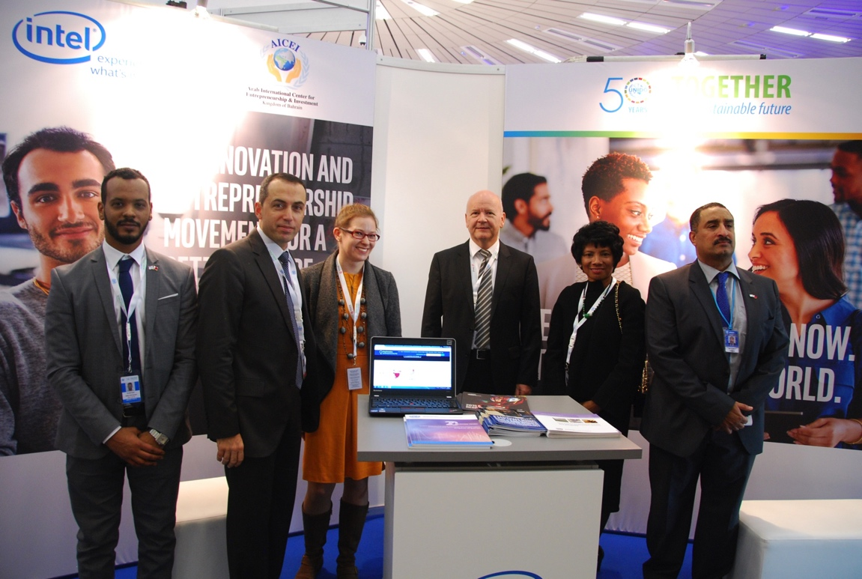
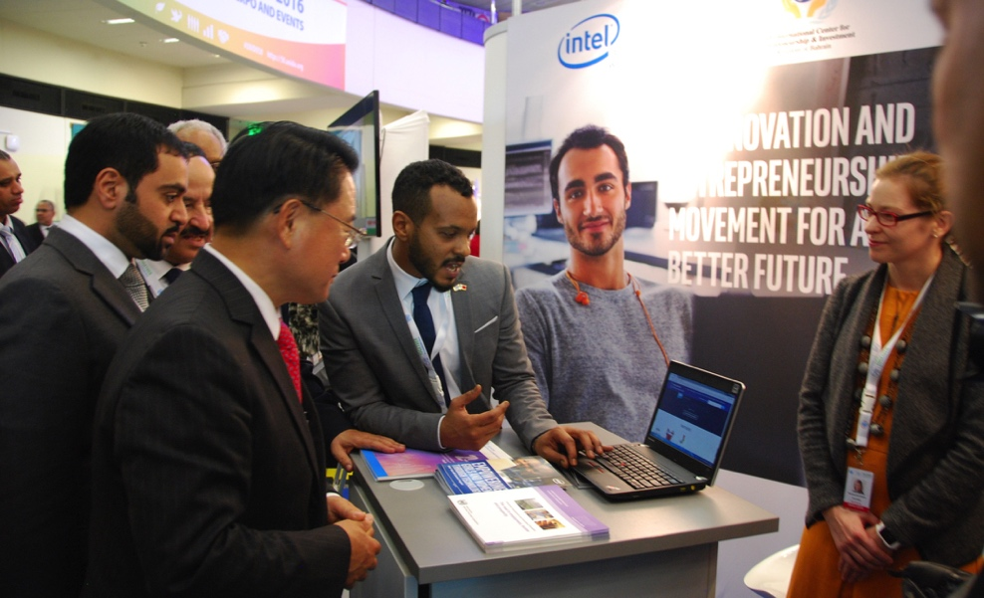
UNIDO 50th Anniversary Expo 2016, Vienna UNIDO ITPO Bahrain 20th Anniversary
Official Launch of the UNIDO – INTEL Virtual Entrepreneurship & Innovation Hub was held during the event.
Through the advanced online platform, the two partners will support the development of Micro and Small and Medium Enterprises (MSMEs); young innovators and entrepreneurs.
Virtual Entrepreneurship & Innovation Hub
e-entrepreneur.org

Slide 42
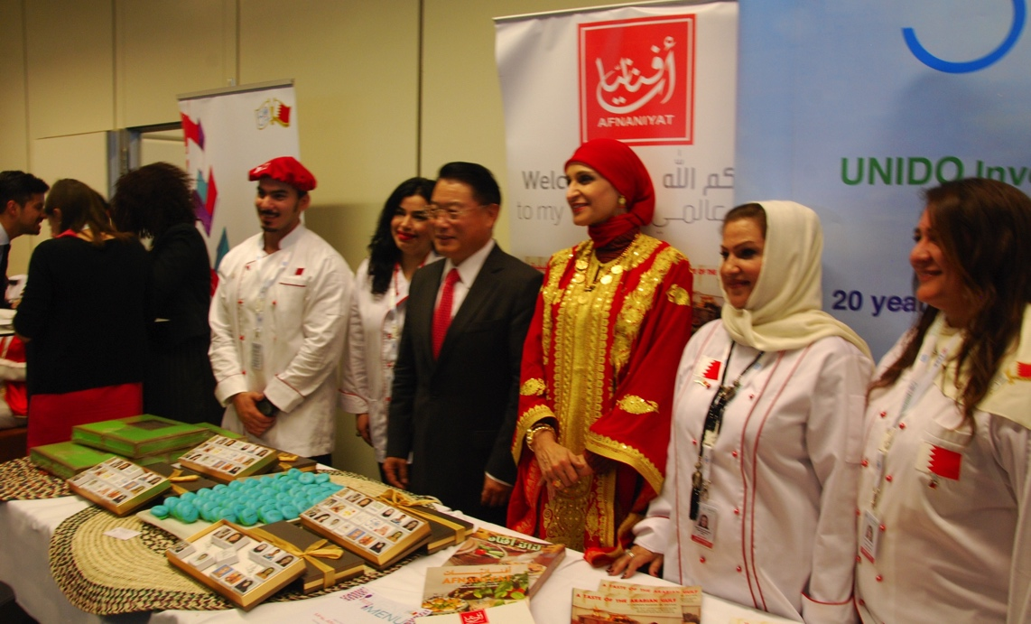
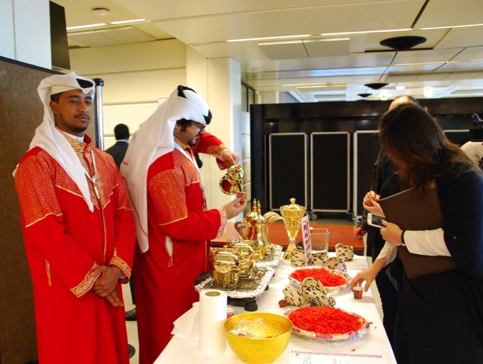
UNIDO 50th Anniversary Expo 2016, Vienna UNIDO ITPO Bahrain 20th Anniversary
“Bahrain Flavors” was the theme of the Anniversary menu during the VIP and UNIDO lunches.
Bahraini chefs, talents, and herbs were showcased with a variety of recipes and exquisite meals, while
Bahraini folklore entertainment was demonstrated.

Slide 43
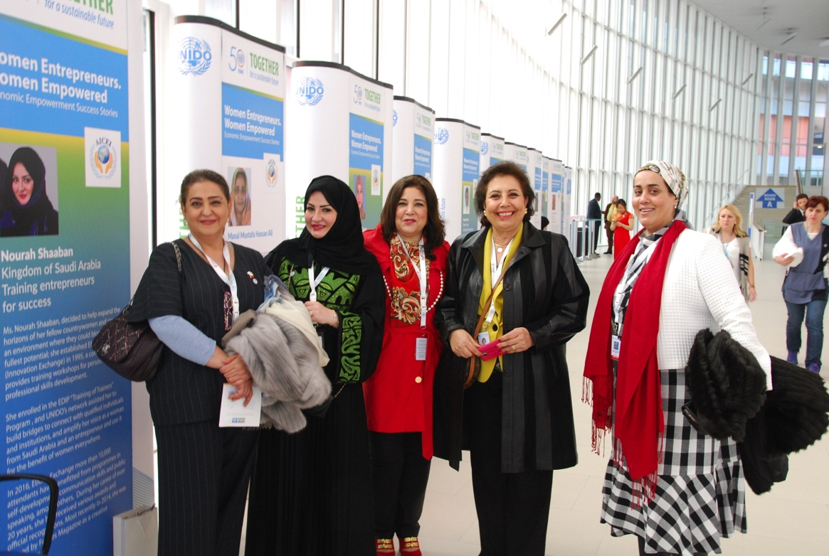
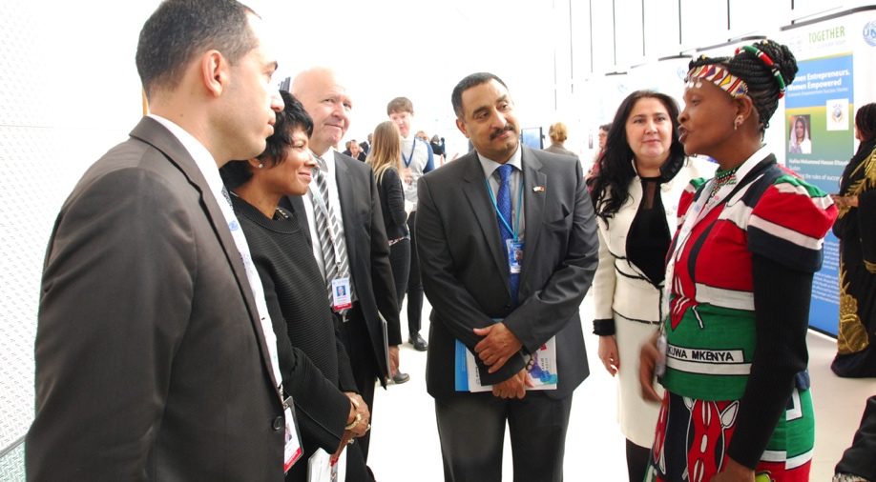
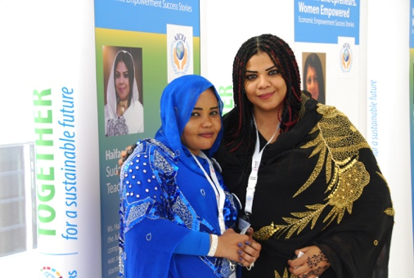
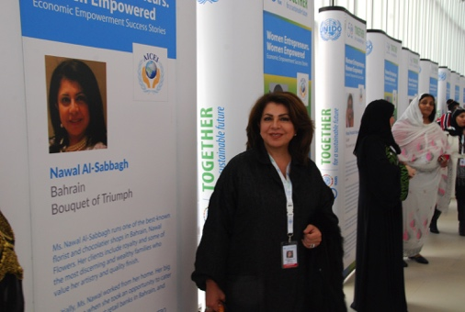
UNIDO 50th Anniversary Expo 2016, Vienna UNIDO ITPO Bahrain 20th Anniversary
16 exceptional women entrepreneurs had their success stories displayed during the event.
These entrepreneurs were empowered the Bahrain modality for entrepreneurship.
The women success stories were also awarded as exceptional and inspirational entrepreneurs.

Slide 44
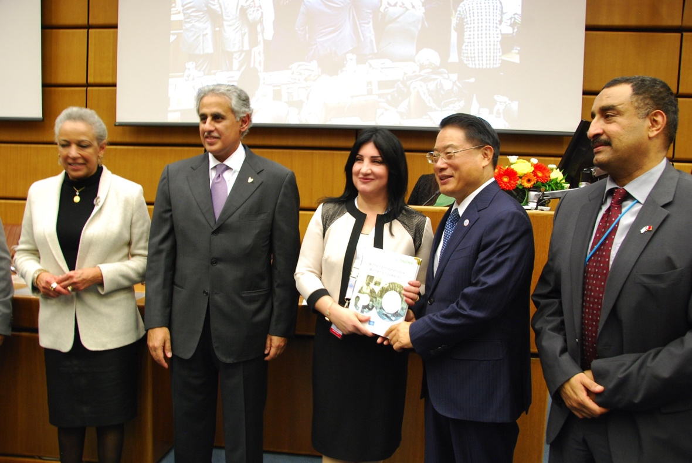
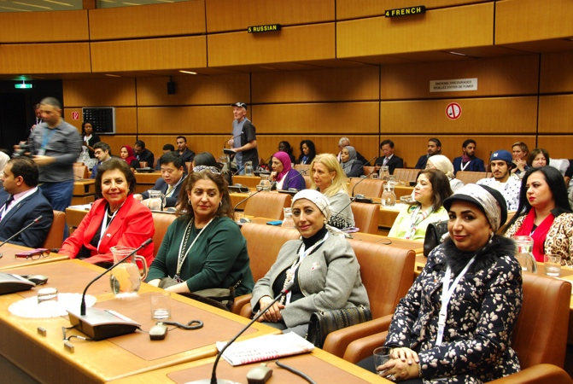
UNIDO 50th Anniversary Expo 2016, Vienna UNIDO ITPO Bahrain 20th Anniversary
Expo Main Event: Women Panel was hosted by BBC’s Ms Al Badawi, featuring UNIDO’s work towards gender equality and women’s empowerment.
This coincided with the launch of the 1st edition of “Women Entrepreneurs. Women Empowered” report, featuring 16 women entrepreneurs empowered by the Bahrain Model (Bahrain, China, Egypt, Kenya, Kuwait, Lebanon, Saudi Arabia, Sierra Leone and Sudan), and an awards ceremony for the same.

Slide 45
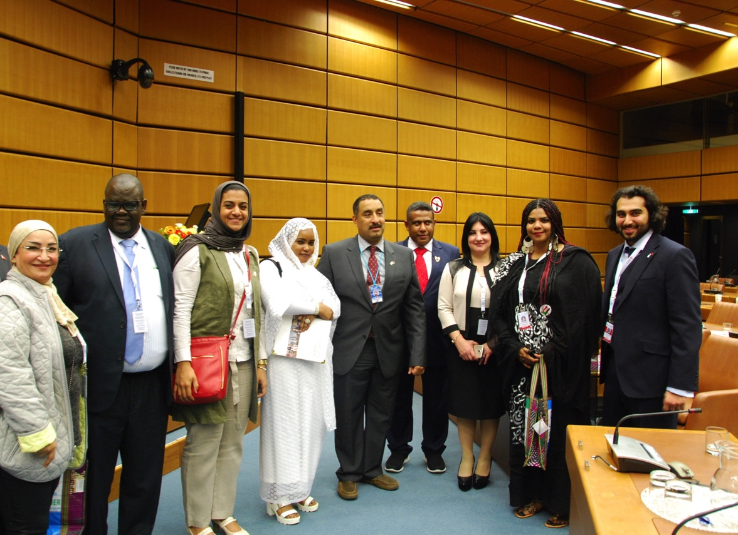
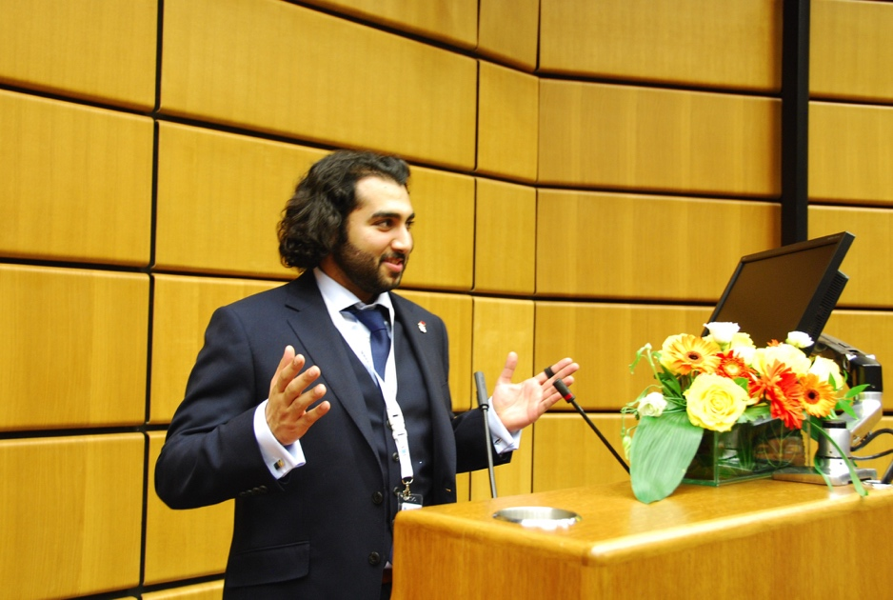
UNIDO 50th Anniversary Expo 2016, Vienna UNIDO ITPO Bahrain 20th Anniversary
Expo Event: Youth Panel “Prosperity: Promoting Youth Entrepreneurship through Start-ups” The Panel was open to entrepreneurs and the youth from around the globe to explore possibilities of cooperation and joint investments with potential counterparts.

Slide 46
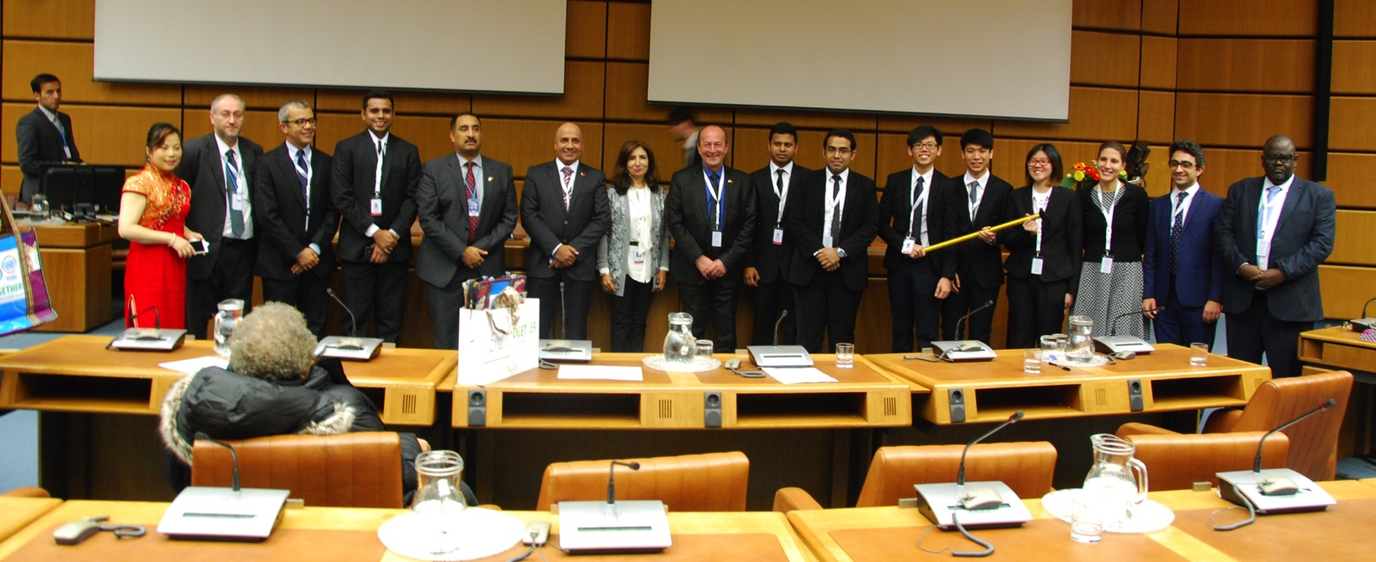
UNIDO 50th Anniversary Expo 2016, Vienna UNIDO ITPO Bahrain 20th Anniversary
Global Startup Business Plan Competition: Organized by the UNIDO ITPO Bahrain Office in cooperation with the Global Entrepreneurship Week, the Islamic Corporation for the Insurance of Investments and Export Credit and through the financial support of Tamkeen the SME, the GSBPC competition resulted with tremendous success. ITPO Bahrain received 825 applications containing unique and innovative business ideas, from 94 countries. The 3 Finalists were hosted and awarded in Vienna.

Slide 47
UNIDO Bahrain
Information & Technology Promotion Office
Arab International Center for Entrepreneurship & Investment

